Slide 1
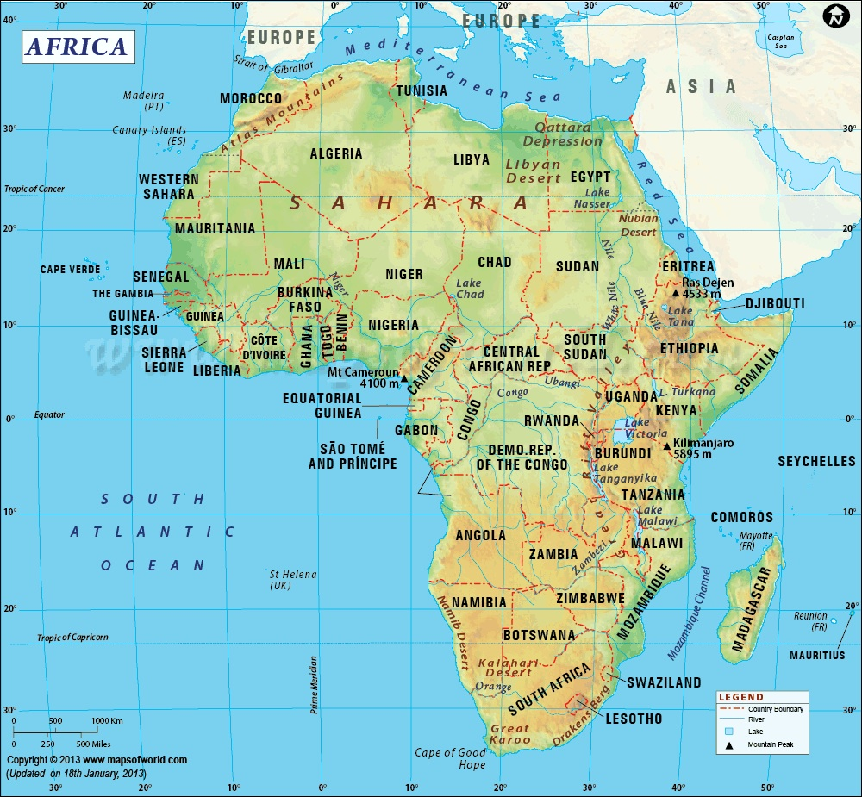
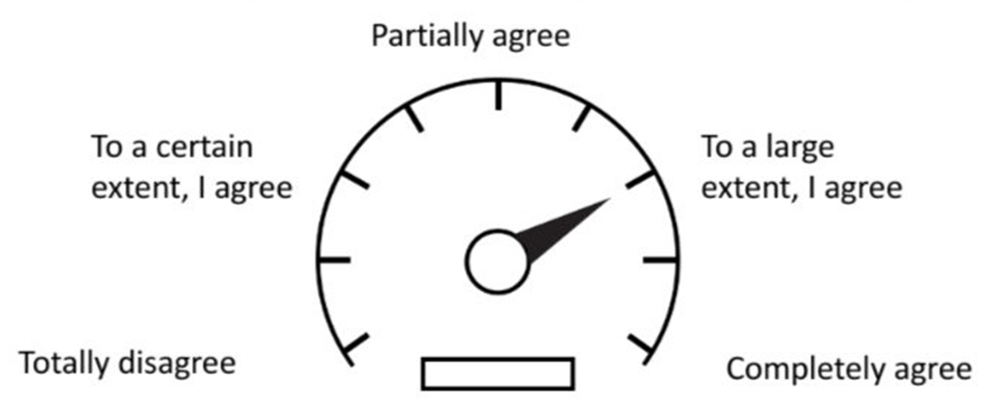
Amazing Africa
Lesson 1: What and where is Africa?
Independent research links
Video links
Geography for Kids: Africa
https://bit.ly/3eayprp
Kid’s World Travel Guide: Africa
https://www.kids-world-travel-guide.com/africa-facts.html
Geography of Africa
https://bit.ly/2Xq0ViN
Geography of Africa: Florida Pass
https://bit.ly/2XjJMHt
Viral Video about African Stereotypes https://bit.ly/39UDQXO
Describe the location of Africa (hemisphere, location in relation to other continents, scale, compass directions)
Watch the first two videos and read the Geography for Kids and World Travel Guide information about Africa. Write down key facts from your research that makes Africa so amazingly diverse. Challenge – can you divide these facts into human and physical features? Try to use a colour code.
Diverse means showing a great deal of variety; very different. "a culturally diverse population"
What are your Amazing Facts about Africa?
Now watch the Viral Video about African Stereotypes. Next, shade in on the continuum below to indicate the extent to which you think stereotypes and inaccurate understanding of Africa today is the greatest challenge people on this continent face. Add an annotation to justify your opinion.

Slide 2
Lesson 2: How Diverse is Africa?
A Diverse Continent
Independent research links
Video links
Article on the Diversity of Africa
https://bit.ly/3aZuqfa
How much do you really know about Africa
https://bit.ly/3cdkCOZ
The Diverse People of Africa
https://bit.ly/34oDNCJ (just pages 2-3)
How Africa could one day rival China
https://bit.ly/2yKkU16
12 Fun Facts about the African Continent
https://bit.ly/34sgyaP
Africa is sometimes referred to as the richest continent in terms of its natural wealth. It has large deposits of many metal ores, such as lithium, cobalt, iron, uranium, aluminium and copper. Additionally, it is one of the top continents for gold and diamonds. It has 10% of the world’s known oil deposits – but it could have even more! Thanks to its range of climates, it can grow a wide range of crops, like cotton, flowers, rubber, tea, coffee, and fruits.
Use the independent research links and videos above to create a detailed mind map describing how diverse Africa is in terms of its places and people.
How diverse is Africa?
Research the biggest challenge to Africa: How can the countries of Africa use its natural wealth and the talents of its people to end poverty? (See the first Africa video as a starting point)

Slide 3
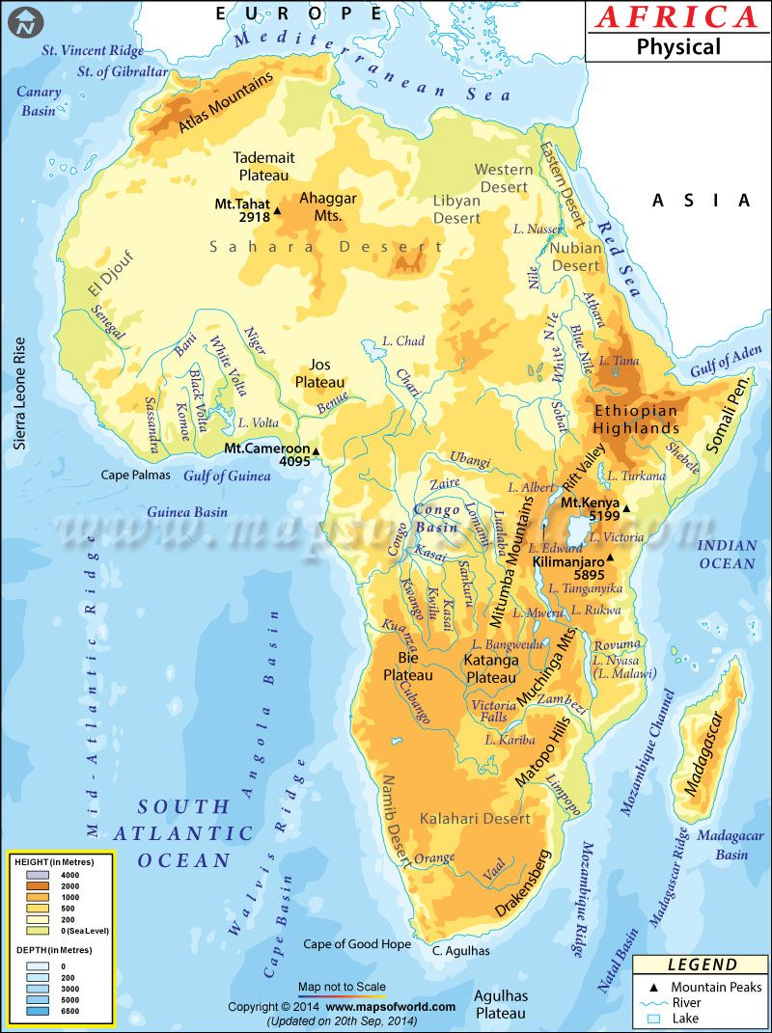
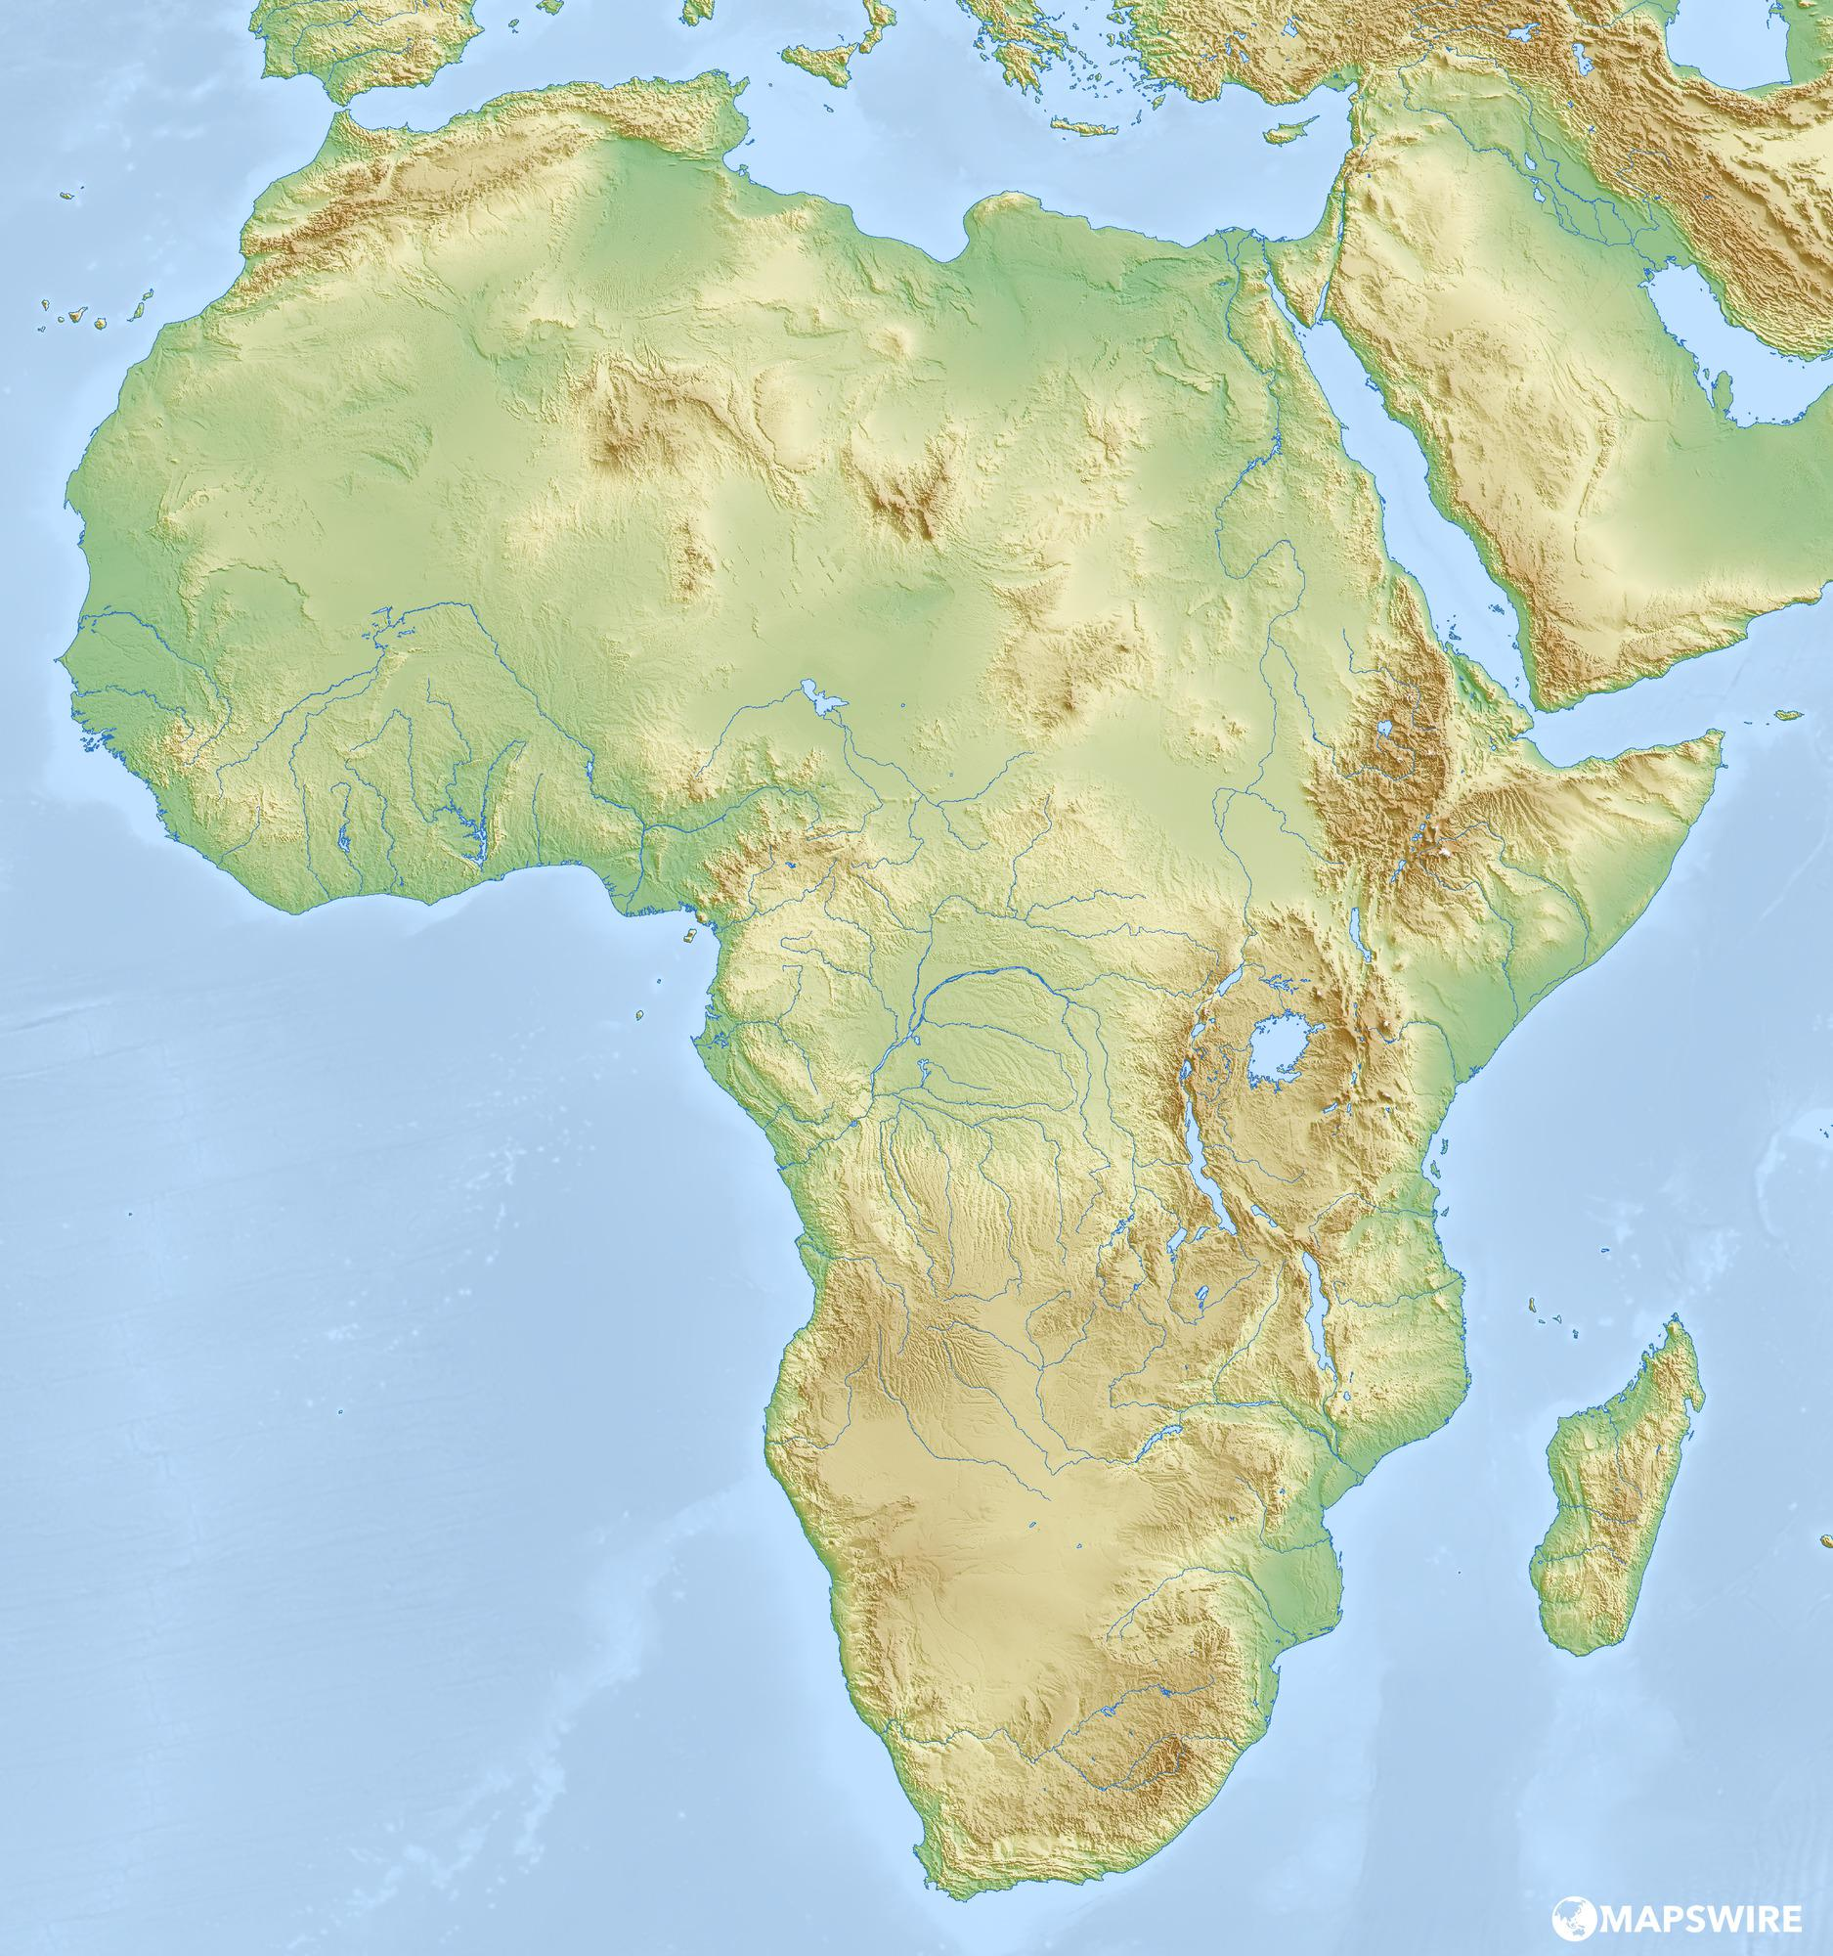
Africa’s Diverse Physical Features
Lesson 3: What are the Major Physical Features of Africa?
Independent research links
Video links
National Geographic Encyclopedia
https://bit.ly/2xg4Bc7
Lonely Planet Kids
https://bit.ly/3eeaK9d
Geography of Africa
https://bit.ly/2Xq0ViN (watch from 2.26)
Africa Destination World
https://bit.ly/2JRQoof
Physical Geography is about the Earth’s natural features (mountains, weather, rivers, etc.)
Add to the map details of the main physical features of Africa (including biomes). Use the links and videos above to help you fill in at least 8 different physical features. Challenge: Explain how diverse Africa’s physical geography is, from North to South and East to West.

Slide 4
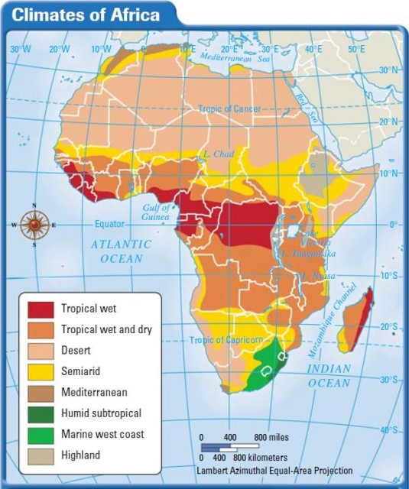
Lesson 4: What is the climate like across Africa?
Africa’s Diverse Climate
Independent research links
Video links
Climate of Africa
https://www.britannica.com/place/Africa/Climate
Africa’s Climate and Vegetation
https://bit.ly/2JUH2Z4
Climate and Vegetation Zones
https://bit.ly/3b0QVAa
How Africa is affected by Climate Change
https://bit.ly/3e5z2lX
Explore the links above and the video on Africa’s climate and vegetation zones. Use your knowledge and the descriptions below to fill in the blanks for the names of Africa’s 8 different climate zones.
Watch the video about how Africa will be affected by climate change. Write down at least 6 key points you have found out from the video. Challenge – can you categorise your knowledge into social, economic and environmental impacts
Climate Change and Africa

Slide 5
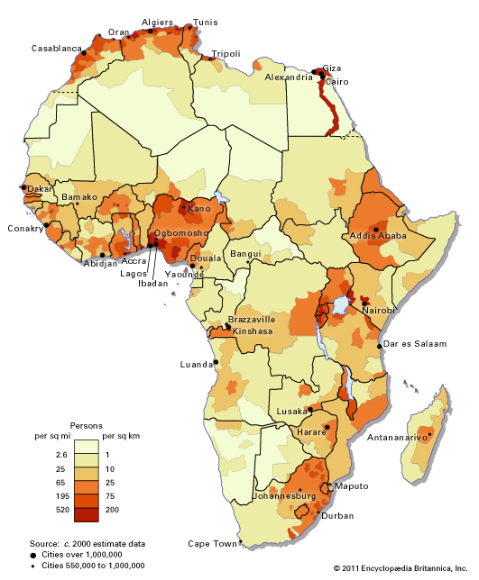
The People of Africa
Lesson 5: Where are all the People in Africa?
Independent research links
Video links
Population Distribution in Africa
https://bit.ly/2XBkk0j
Index Mundi: Population Density Africa
https://bit.ly/3baF2Ys
The Problem of Population Density in Africa
https://bit.ly/2RtQCGt
The Problems with Africa’s borders
https://bit.ly/39YRGs8
Which countries are taking off in Africa
https://bit.ly/2VcVEIw
The Countries of Africa song
https://bit.ly/3aZ8Xml (for fun!)
Population Density the average number of people living in a place, per square kilometre
Using the links above, describe which parts of Africa have high population densities and which
parts have low population densities (countries, regions, compass directions)
Challenge – can you explain why more people live in some locations over others?
Now look at the Problem of Population Density article. Place a cross on the continuum below to indicate the extent to which you think Africa’s population density is its greatest challenge. Add an annotation to justify your decision.
To what extent?
Population density is not a challenge, it is an opportunity
Population density is a challenge
Watch the videos provided. Write down 3 key points you have found out from each video. Challenge – can you explain whether you think the Africa will be successful or not in overcoming its problems?
Problems with Africa’s Borders | Potential Successes In Africa

Slide 6
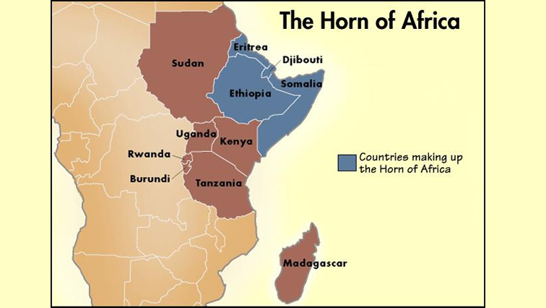
Lesson 6: What challenges do they face in the Horn of Africa?
Independent research links
Video links
The Horn of Africa Wikipedia for Schools
https://bit.ly/2JUhtHB
New World Encyclopedia Horn of Africa
https://bit.ly/2VjA8C0
The Horn of Africa
https://bit.ly/3cb6UMy
Survival in the Horn of Africa
https://bit.ly/2y0QRC2
The Horn of Africa buzzing with Hope
https://bit.ly/2RuoYt3
The Horn of Africa is a region in north east Africa that is made up of four countries: Djibouti, Eritrea, Ethiopia, and Somalia. Even though all of these countries are as diverse as the rest of the continent, they also have a lot in common. People sometimes include other countries when referring to the Greater Horn of Africa: Sudan, South Sudan, and Kenya.
Use the links and videos above to create a mind map describing what the Horn of Africa is like – using physical and human features. Challenge – highlight which characteristics pose challenges for this region.
The Horn of Africa
Using your knowledge from the above task, identify at least 4 challenges facing the people of the Horn of Africa today, rank these and then provide you reasons for your rankings.
Challenge | Ranking | Your reason

