Slide 1
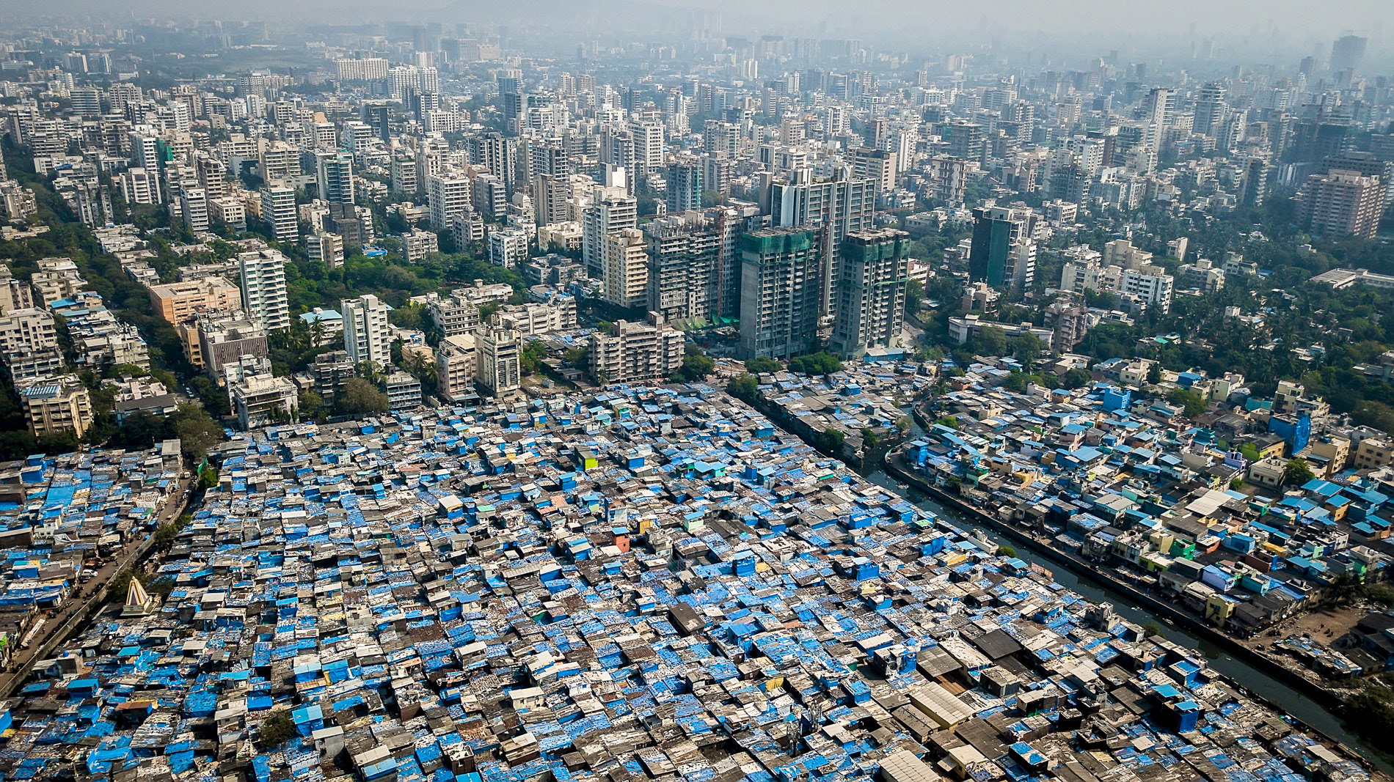
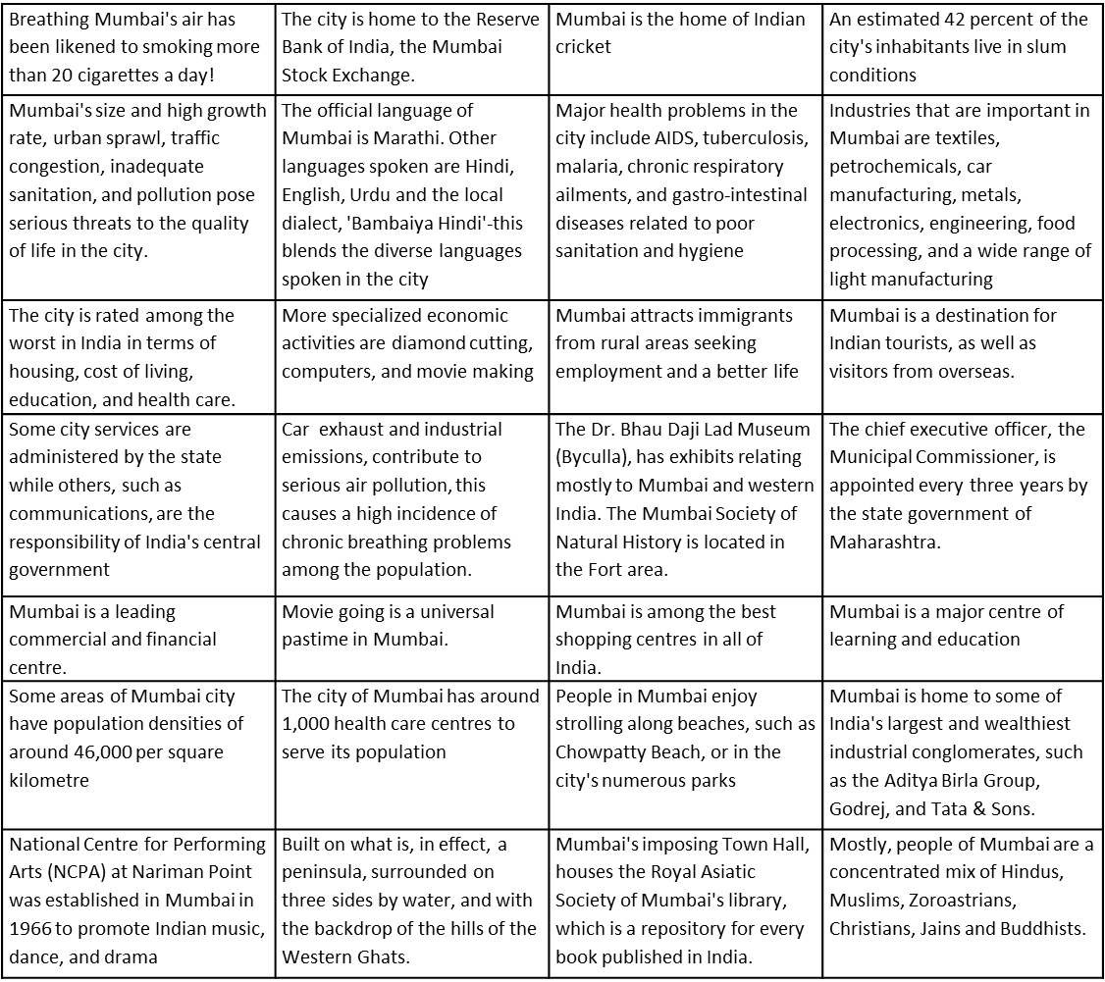
Amazing Africa
Lesson 7 - Mumbai: A Growing Megacity
Challenges of an Urbanising World- Mumbai
Independent research links
Video links
Site and Situation information.
https://bit.ly/35azOtT
Introducing Mumbai- https://bit.ly/3cSGHSZ
While watching the video clip ‘Introducing Mumbai’ NOTE 10 things to describe what Mumbai is like.
Colour code each of the following pieces of information into political, social, cultural and environmental. Check out the website instructions for help!

Slide 2
Amazing Africa
Lesson 7 - Mumbai: A Growing Megacity.
Challenges of an Urbanising World - Mumbai
Where is Mumbai? Use google to research where Mumbai is and then write a paragraph to DESCRIBE its location including which hemisphere it is in, which continent, which country and where it is in that country.
The site was the actual place where people decided to locate their settlement.
The situation of a settlement is its position in relation to the surrounding human and physical features.
READ through the key terms above. Now use the ‘Site and situation information’ link to find out information about he site and situation of Mumbai. ADD this information into the table below.
Site | Situation

Slide 3
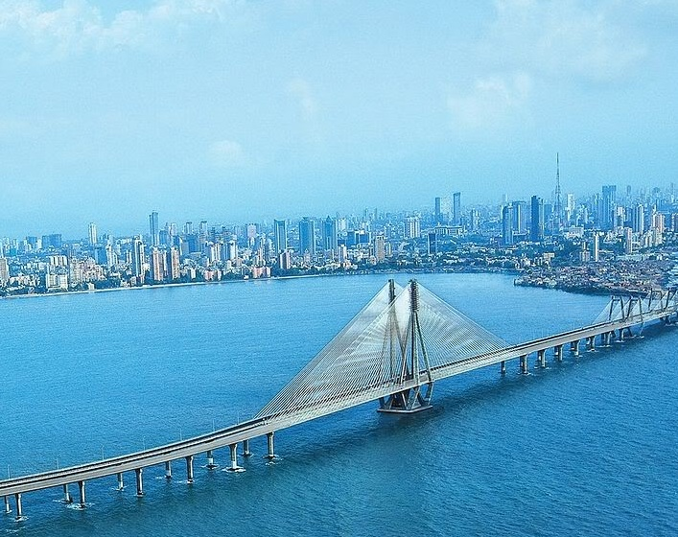
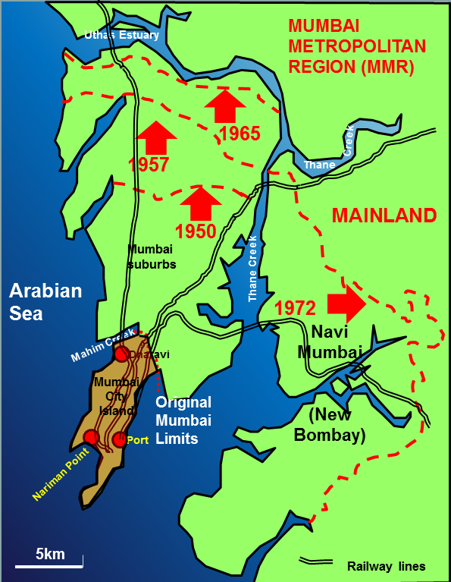
Challenges of an Urbanising World
Lesson 8 - Mumbai’s Growth.
Independent research links
Video links
Population change graph- https://bit.ly/2xevaOM
Changing Mumbai- https://bit.ly/2VHmbiE
Optional video- how Bombay became Mumbai city!
https://bit.ly/2xeSThQ
Carefully look at the ‘Population change graph’.
In 4 sentences DESCRIBE what is happening in the graph. Use data in your answer.
LOOK at the map to the left. DESCRIBE how Mumbai has changed from 1950 to 1972.
Visit the ‘Changing Mumbai’ research link. Use this space to take SUMMARY notes about what Mumbai is like to live in and how it has changed over time.

Slide 4
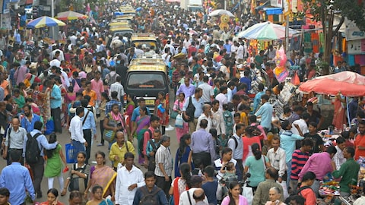
Challenges of an Urbanising World
Lesson 9 - Mumbai’s Changing Population.
Independent research links
Mumbai population statistics.
https://bit.ly/2Sc2uNG
Video links
Optional video- population in India.
https://bit.ly/3aJArMa
MATCH up the key words with the correct definition.
Death rate minus birth rate
The number of people in an area
The number of babies born per 1000 people
Population
Birth rate
Death rate
Natural increase
Rural
Urban
Migration
Push factor
Pull factor
Economic investment
Hyper-urbanisation
Rural-urban migration
The reasons why people to choose to leave a place – negative factors
Built up areas - towns and cities
The number of deaths per 1000 people
The reasons why people move to a place – positive factors
The countryside
Super fast rate of urbanisation
Money spent within the city to develop industry and wealth
The movement of people from one place to another
The movement of people from the countryside to the city
READ this information. HIGHLIGHT the key points!

Slide 5
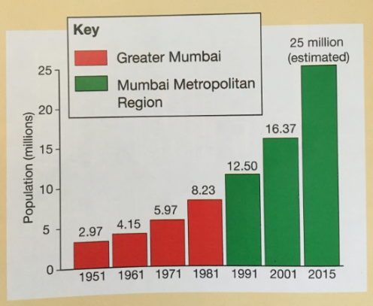
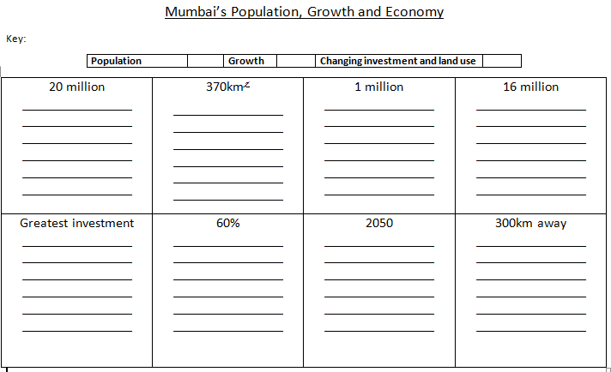
Challenges of an Urbanising World
Lesson 9 - Mumbai’s Changing Population.
DESCRIBE what this population graph of Mumbai shows.
Use the ‘facts about population’ sheet to complete the boxes. The first has been done for you!
Mumbai will reach this population in 2020

Slide 6
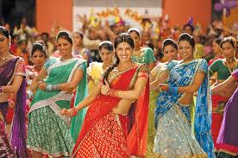
Challenges of an Urbanising World
Lesson 10 - Opportunities and Challenges.
Independent research links
Opportunities Quizlet.
https://bit.ly/3eZDBP3
Opportunities spider diagram
https://bit.ly/3aMbz6g
Challenges in Mumbai
https://bit.ly/3aJZKNX
Video links
Walking through Mumbai.
https://bit.ly/3eZDBP3
Visit the ‘opportunities quizlet’ and use the flashcards to CREATE a spider diagram of the opportunities available in Mumbai. You can play some of the games too!

Slide 7
Challenges of an Urbanising World
Lesson 10 - Opportunities and Challenges.
Use the ‘challenges in Mumbai’ sheet to complete the tasks below.

Slide 8
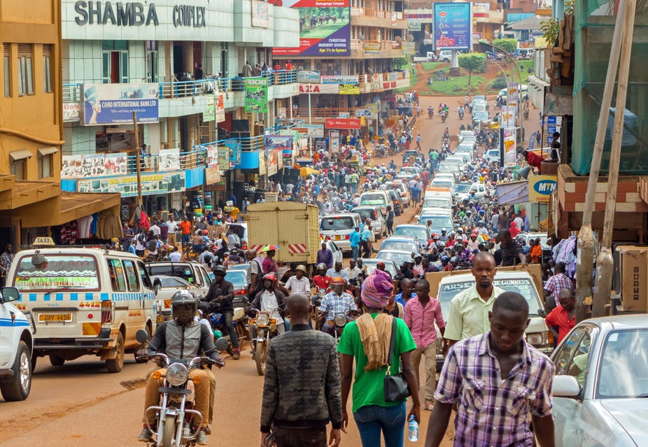
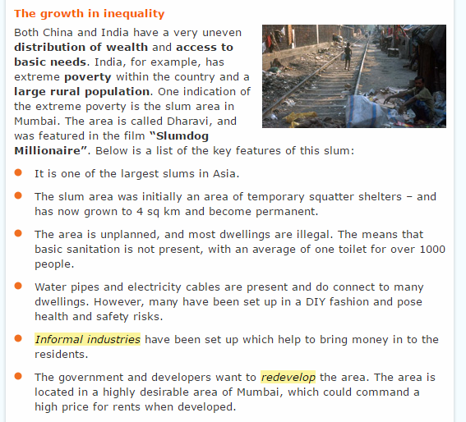
Challenges of an Urbanising World
Lesson 11 - Quality of Life in Mumbai.
Independent research links
Video links
Living in different parts of the city.
https://bit.ly/2W8xUWj
Slumming it
https://bit.ly/2zJxv5r
Quality of Life
A measure of how wealthy people are, using criteria such as housing, employment and environmental factors (rather than income)
Informal economy
Unofficial economy, where no records are kept. No contracts or employment rights.
Starter: Watch 5 minutes of Slumming IT with Kevin McCloud. Start the video from 2min 30seconds in!! Write a DESCRIPTION of what you think it would be like to the Dharavi slum.
Task: READ the information about inequality.
1) Highlight the key features of a slum.
2)What do you understand by the term ‘uneven distribution of wealth’?
3) What do you understand by access to basic needs?

Slide 9
Challenges of an Urbanising World
Lesson 11 - Quality of Life in Mumbai.
Independent research links
Video links
Living in different parts of the city.
https://bit.ly/2W8xUWj
Slumming it
https://bit.ly/2zJxv5r
Quality of Life
A measure of how wealthy people are, using criteria such as housing, employment and environmental factors (rather than income)
Informal economy
Unofficial economy, where no records are kept. No contracts or employment rights.
Task: READ through the three pieces of information about living in Dharavi, the suburbs and Colaba. Use it to complete the table below!
 | Describe the living space | Employment and salary | Educational opportunities | Entertainment
Quality of life at the bottom - Dharavi
Quality of life in the middle – the Mumbai suburbs
Quality of life near the top – harbour area of Colaba

Slide 10
Challenges of an Urbanising World
Lesson 12- Vision Mumbai, Sustainable Mumbai?
Independent research links
Models of sustainability.
https://bit.ly/3d0SQ8q
Vision Mumbai information
https://bit.ly/2Yg9tZW
Video links
What is sustainability?
https://bit.ly/3f2R0G8
Watch the video called ‘What is sustainability’. Use the video to write down your definition of sustainability.
Sustainable development: “Development that meets the needs of the present without compromising the ability of future generations to meet their own needs”.
Look at the ‘models of sustainability link. Create a sketch of each one. Challenge: Which one is your favourite? Why?

Slide 11
Challenges of an Urbanising World
Lesson 12- Vision Mumbai, Sustainable Mumbai?
Vision Mumbai – An example of top-down development
Explain why Vision Mumbai is a top-down development. | What was the aim for Mumbai? (targets)
Give some examples of things that were seen as ‘quick wins’. | What was the main plan for Mumbai?
 | Did the vision work?
Did everyone like the changes? | In spite of the plans, what is Mumbai like today?

Slide 12
Challenges of an Urbanising World
Lesson 13 - Sustainable Development in Mumbai
Challenges of an urbanising world
Independent research links
Video links
Optional video- LSS.
https://bit.ly/3aJOnWt
Top Down VS Bottom up development
https://bit.ly/2yW6Y45
LSS Information
https://bit.ly/2YfnnLH
Quiz- https://bit.ly/3bOfFfn
Visit the top down vs bottom up development link.
WRITE down three bullet points about each type of development.

Slide 13
Challenges of an Urbanising World
Lesson 13 - Sustainable Developlement in Mumbai
Complete this google quiz: https://bit.ly/3bOfFfn. Make sure you include the name of your teacher and your class. When you have completed it, it will give you a score.
Total marks:
Give yourself a PM (something that went well. For example, an answer your got correct, if you did well on case study details, if you knew a lot of key terms. Then give yourself a PF (something you need to improve with. Pick one answer that you got wrong and write it out in full as your PF task.
PM:
PF:
Improvement using the model answer:
REFLECT on your learning over the last several lessons and how well you have worked through the booklet. Give yourself 2 stars – positives, and a wish – something to push for.

