Slide 1
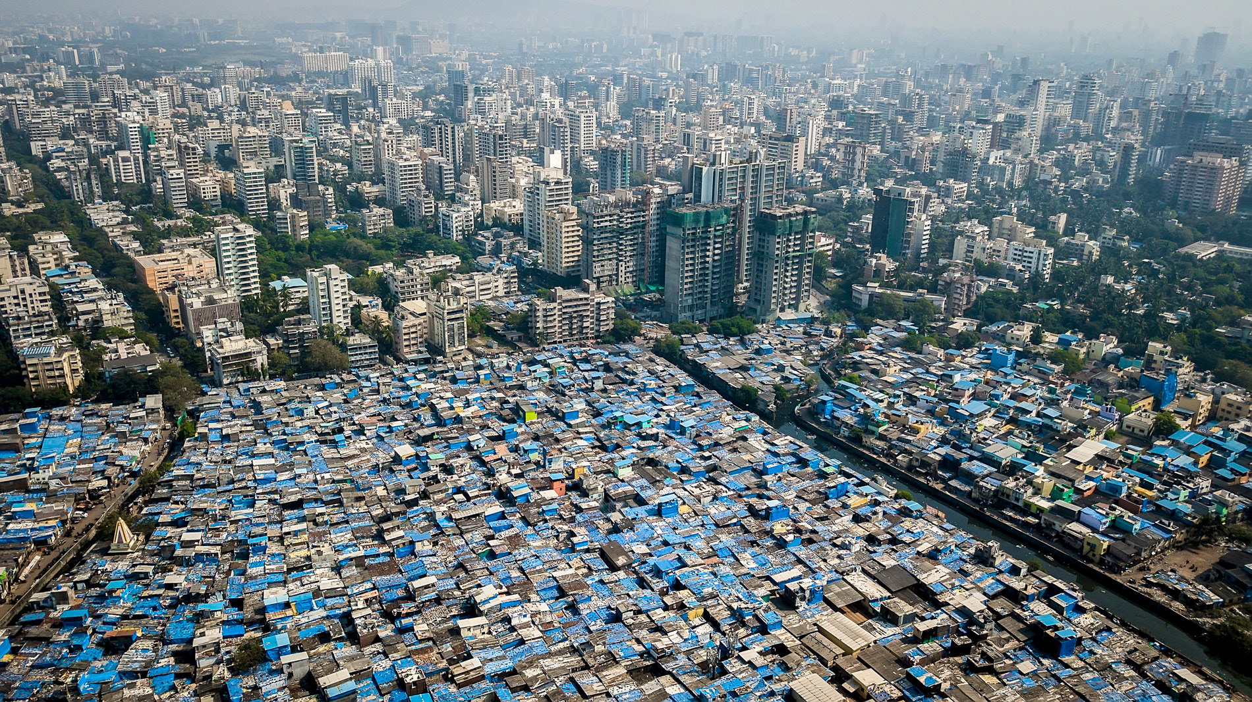
Amazing Africa
Lesson 1: A world of growing cities.
Challenges of an urbanising world
Independent research links
Video links
Geographical association- Urbanisaiton. https://bit.ly/3bybW5C
Dictionary of Geographical terms-
https://bit.ly/2x5D1hJ
Optional video that gives a great introduction to urbanisation:
https://bit.ly/2VwxDgR
Go to the first independent research link- Geographical association- urbanisation. READ the information, WATCH the video and ANSWER the questions below.
What is the definition of urbanisation?
Where in the world is most urbanisation happening now?
More key terms for the topic! Use independent research to match up the key terms with their definitions.

Slide 2
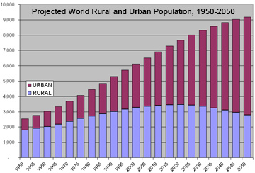
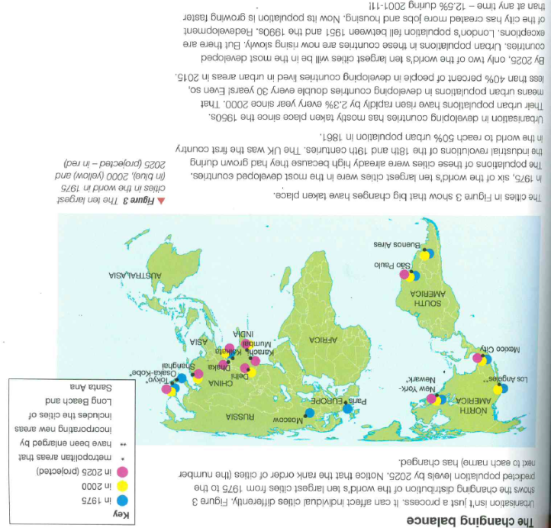
Amazing Africa
Lesson 1: A world of growing cities.
Challenges of an urbanising world
Carefully look at this graph.
In 4 sentences DESCRIBE what is happening in the graph. Use data in your answer.
READ through the information below. Highlight all the key points! Challenge – can you suggest why some cities have grown rapidly while others have not?

Slide 3
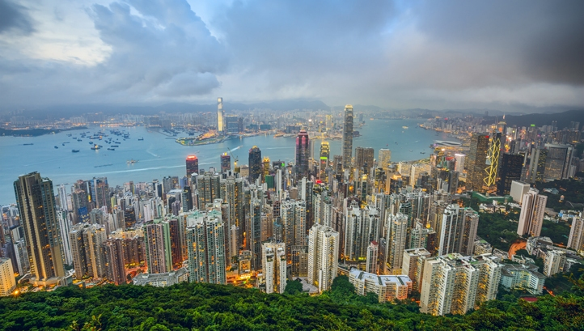
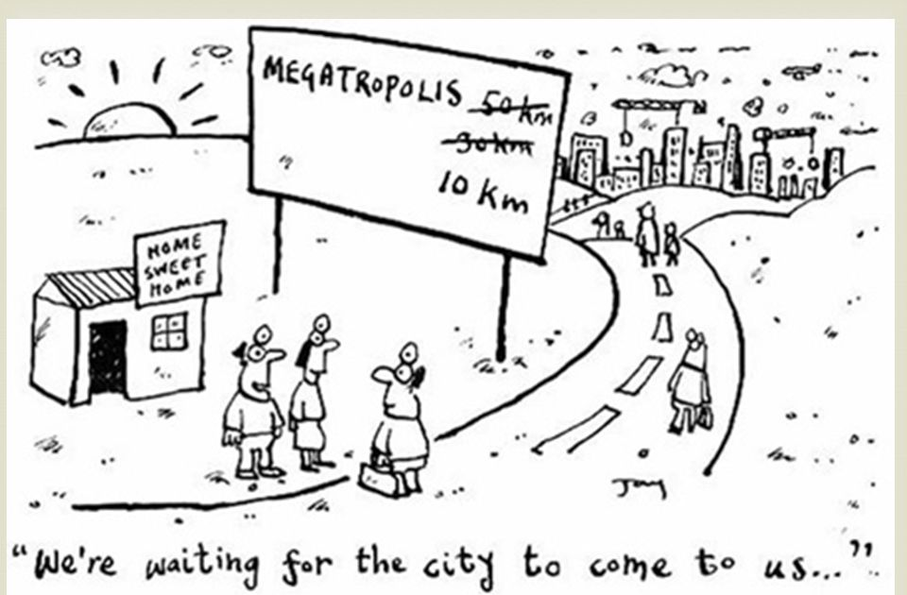
Challenges of an urbanising world
Lesson 2: The world’s megacities.
A Diverse Continent
Independent research links
Bright lights, big cities. Interactive map!
https://econ.st/2VwxU3n
Video links
What are the world’s largest cities?
https://bit.ly/2VPUOlg
Optional: Tokoyo: Earth’s model megacity. https://bit.ly/2zuO1Gl
Megatropolis - Very large urban area that consists of several suburbs that join each other.
LOOK at the cartoon. What do you think it is trying to show?
Watch the video called ‘What Are the World’s Largest Cities’. Use spider diagram space below to note down as many facts and figures as you can!
Megacities
LOOK at the bright lights, big cities interactive map. USE the sliding date scale at the bottom of the map to EXPLORE how the location of megacities changes over time. WRITE a quick summary of the changes from 1950 to 1990 and then 1990 to 2030.

Slide 4
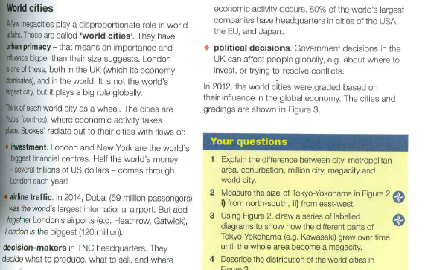
Challenges of an urbanising world
Lesson 2: The world’s megacities.
Task:
READ the information about world cities. You should highlight the key information as you read. Use google to research any new key words that you don't understand. Use this information to complete the table below the information.
Term: | Definition: | Benefit:
Investment | .
Political Decisions
Airline Traffic
Decision Making

Slide 5
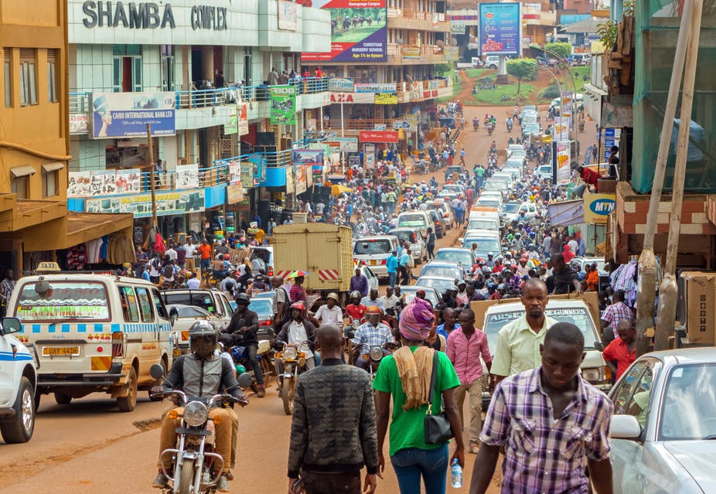
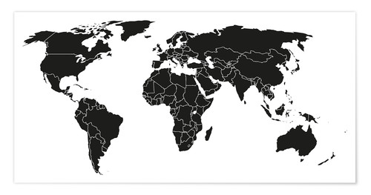
Challenges of an urbanising world
Lesson 3: Urban process and change.
Independent research links
Video links
Urban Change Case studies
https://bit.ly/2XZH5Lq
Urbanisation in China.
https://bit.ly/3eHlbTb
Watch this video about China's urbanisation. Use it to WRITE down what you think has caused urbanisation in China. You need at least 4 sentences.
DRAW arrows to Detroit, New York and Kampala on this map then label them. Underneath each label, use the Urban Change Case Studies link to describe what is happening to the population (is it increasing or decreasing) and then explain why.

Slide 6
Challenges of an urbanising world
Lesson 4- How urban economies differ.
Africa’s Diverse Climate
Independent research links
Urban economies case studies link.
https://bit.ly/3bEzLc4
Model answer for exam question.
https://bit.ly/3eMU5dq
Video links
Formal and informal economy.
https://bit.ly/2KuivdD
Use google images to search for pictures of Kampala, New Delhi and New York. WRITE down the key differences you spot between these locations.
Formal economy- means one which is official, meets legal standards for accounts, taxes and workers’ pay and conditions.
Informal economy- Mean an unofficial economy, where no reports are kept. People in the informal economy have no contacts or employment rights.
Write down 3 examples for each type of employment. Stuck? Use the formal/ informal video above!
Look at the urban economies case studies link. Use the information about the 3 different locations. Below, note down the % of GDP of the informal economy, value of the informal economy in US$, main jobs in the informal economy of your city and the main jobs in the formal economy of your city (including sector characteristics) for each location.

Slide 7
Challenges of an urbanising world
Lesson 4- How urban economies differ.
Africa’s Diverse Climate
Explain two reasons why the economies of developed and developing world cities differ. (4 marks) Hint- to get 3-4 marks you will have to talk about both developing and developed world cities. Literacy bank: On the other hand However Conversely
When you have answered, go to the model answer for the exam question link. Self assess your answer using the model answer. Give yourself a PM (something that went well and a PF (something that could be better). If you didn't get full marks, steal from the model answer to improve yours!
PM:
PF:
Improvement using the model answer:

Slide 8
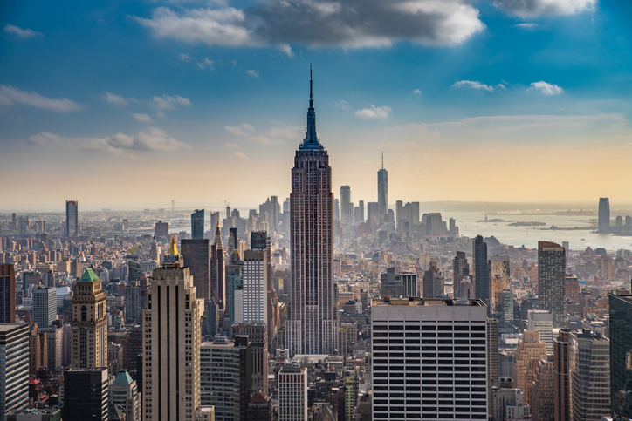
Challenges of an urbanising world.
Lesson 5: The changing face of New York.
Independent research links
Video links
Ellis Island Video- https://bit.ly/2Kz6FPe
Evolution of NYC- https://bit.ly/2VVrnOQ
Empire state of mind.https://bit.ly/2xUMZCU
Changing New York- Information
https://bit.ly/2Y24L1R
Suburbanisation- The movement of people from the inner suburbs to the outer- suburbs
Counter- urbanisation – When people move away from cities completely.
Re-urbanisation- The movement of people back to cities.
STARTER: Introducing Ellis Island! WATCH the Ellis Island video and note down 5 facts/pieces of information about Ellis Island.
WATCH the evolution of NYC video and DESCRIBE the key changes you see over time.
Key Terms Focus: READ the definitions of suburbanization, counter- urbanisation and re-urbanisation above. Use these to DESCRIBE the key differences between each process OR create a diagram to show each of these processes.

Slide 9
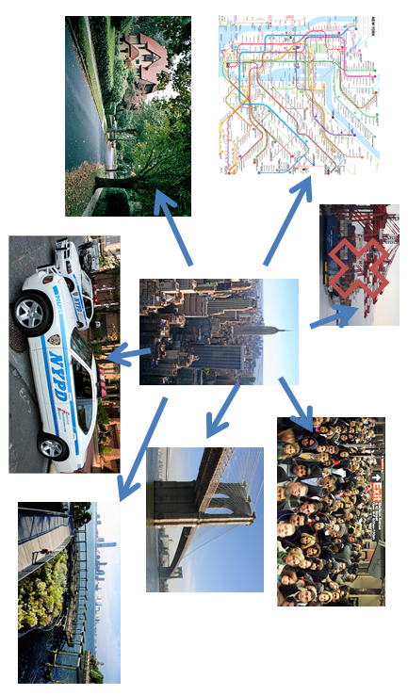
Lesson 4- How urban economies differ.
Challenges of an urbanising world.
Lesson 5: The changing face of New York.
Challenges of an urbanising world
Africa’s Diverse Climate
Use the ‘Changing New York’ information to ANNOTATE off each of these pictures with what process is occurring and extra details about it. Small titles for each picture have been added which link directly to the text! One has been done for you.
Process: Suburbanisation.
Information: Subways and railways were built and opened in 19000. They meant that people could easily travel around the city and love in the outer suburbs with a better quality of life but commute into the city centre for work.
Large house with garden
Subway/ Rail
Zero tolerance to crime.
Closure of the docks
Areas became very congested causing people to move away.
Regeneration
Construction of road bridges.

Slide 10
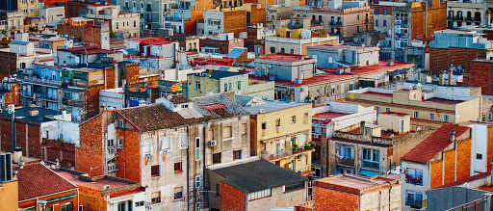
Challenges of an urbanising world.
Lesson 6: Land use in cities.
Independent research links
Video links
Land use zones information
https://bit.ly/3ax4bf6
Why areas develop information.
https://bit.ly/3eT4LY3
Introducing land use zones.
https://bit.ly/3eKjmVn
Stuck on what each of the land use zones are?
https://bit.ly/3bEA1b2
WATCH the introducing land use zones video. Use it to DRAW 3 quick sketches of what types, sizes and characteristics of buildings you’d find in each zone.
Look at the land use zones information link. Use the information on this website to complete the table below.
Land use name | Characteristics | Land Values | Population Density
Central Business District
Inner City
Suburbs
Rural-Urban Fringe

Slide 11
Challenges of an urbanising world.
Lesson 6: Land use in cities.
Use the why these areas develop information to complete the table in your booklet. Try to have a max of 30 words in each box!
Type of land use | Describe the characteristics of the land use in the city (what is it like?) | Explain how these areas develop (why is it like this?)
Commercial (offices and retail)
Industrial
Residential
Complete this google quiz- https://bit.ly/2VRXoaA . Make sure you include the name of your teacher and your class. When you have completed it, it will give you a score.
Total marks:
Give yourself a PM (something that went well. For example, an answer your got correct, if you did well on case study details, if you knew a lot of key terms). Then give yourself a PF (something you need to improve upon). Pick one answer that you got wrong and write it out in full as your PF task.
PM:
PF:
Improvement using the model answer:

