Slide 1
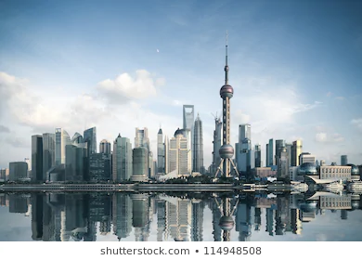
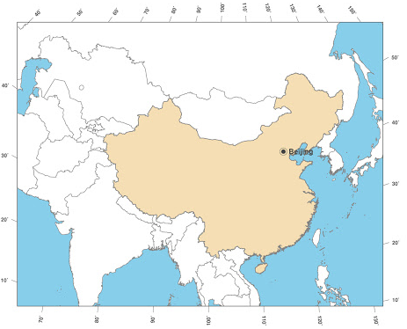
Changing China
Changing China
Lesson 1: Where is China and What are its Physical and Human Features?
Instructions: For each worksheet page, first follow the directions for learning (in black). Second, answer the illustrating your knowledge questions (in dark blue).
Independent research links
Video links
Maps of China
https://bit.ly/3aPzzXX
Human Physical Features of China.
https://bit.ly/3gobQiA
Introducing China- https://bit.ly/34qNwu2
Task 1&2- Use your own knowledge to create a spider diagram showing what you already know about China. Now watch the introducing chian video and add to your notes to show what China is like.
Task 3- Use the Maps of China information to write a short paragraph describing the location of China.
Physical Geography is about the Earth’s natural features (mountains, weather, rivers, etc.)
Human Geography is about how human activity affects or is influenced by the earth’s surface.
Main task 4. (10mins) Use the ‘Human and physical features maps’ to add the bordering countries and following cities to your map: Shanghai, Guagzhou, Chongqing, Qingdao, Tianjin, Shanyang, Wuhan, Tianjin. Now label at least 5 of the bordering countries. For example, Mongolia, Russia, North Korea, Vietnam and Laos.
Main task 5 (10mins) Now use a colored pencil to shade the map to show the relief of the land. Use this map to help you! You should shade the highest areas in a darker colour and the lower areas in a lighter shade.

Slide 2
Changing China
Changing China
Lesson 2: How is China Changing?
Independent research links
Video links
Key changes in China.
https://bbc.in/2QmuI7g
China headlines- https://bit.ly/2YsajlF
Time Lapse of China- https://bit.ly/2EyqSFu
Watch the Time Lapse of China video. Use this to write a quick description of what has happened to China’s cities overtime. Why do you think this change has happened?
Look at the key changes in China research link. Use this to create a spider diagram of the key changes that have happened in China over the last 40 years. You should include at least 10 pieces of information.
Key Changes in China
Read the news paper headlines link. Pick out three social (about people), 3 economic (about money) and 3 environmental (about the natural world or pollution) headlines and add them to the table. Next to each one, say if you think it is a positive or negative change.
Social | Economic | Environmental

Slide 3
Changing China
Changing China
Lesson 3- Rural to urban migration.
Independent research links
Video links
Population and migration in Asia
https://bbc.in/3aU26ve
Rural to urban migration story.
https://bit.ly/34p9fml
Rural to urban migration- https://bit.ly/2EcuFIM
China: The largest migration in history https://bit.ly/3lfskgP
Watch the rural-urban migration video. What is rural to urban migration?
Watch the ‘China The largest migration in history’ and read the ‘population and migration in Asia’ link. Use these to describe what the population in China is doing and WHY.
Read the rural to urban migration story. Use the story to write a letter pretending that you are Zhao and you are explaining what your life is like now that you have moved to the city.
You need to make sure you have (tick them off as you go):
I have addressed the letter Dear wife…
I have explained the Urban area where I am. (Where I am living, what my quality of life is like, why did I come? Why is this environment like it is?)
I have explained what the journey was like from the rural to the urban area
I have explained why I left the Rural area (push factors), what it is like to live here and why it is like this.
I have explained what should be done in the next 12 months (should the rest of the family move to the city too?)
Challenge: ​Evaluate the advantages and disadvantages of living in each place.

Slide 4
Changing China
Changing China
Lesson 4- Manufacturing in China.
Independent research links
Video links
Products made in China. https://bit.ly/3hpu5Fz
Pros and Cons of outsourcing.
https://bit.ly/3gtYEsp
Apple manufacturing in China (optional but highly recommended!)
https://bit.ly/3aR2DOJ
Use the ‘Products made in China’ link to to create a spider diagram of the different products that are made in China. Challenge: Include facts and figures to add details to your notes.
Products made in China.
Outsourcing is obtaining key products from alternative, cheaper locations - often abroad - than original home-sources.
China has been a key country where companies have outsourced manufacturing to for over 20 years. There are a range of positives and negatives of this outsourcing. Use the information ‘Pros and cons of outsourcing’ to create a table detailing the positives and negatives of outsourcing to China.
Positives | Negatives

Slide 5
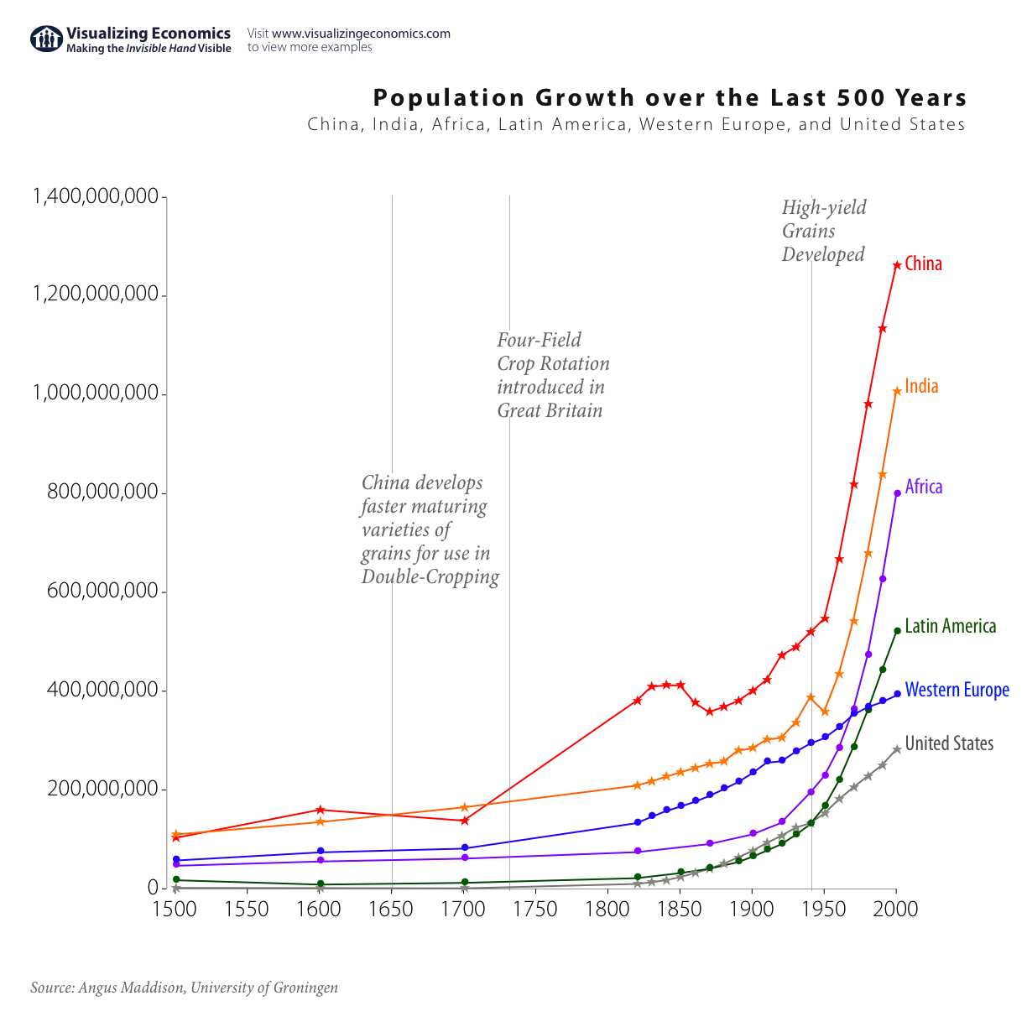
Changing China
Changing China
Lesson 5- China’s One Child Policy.
Independent research links
Video links
One Child Policy- https://bit.ly/3gpGJTN
Gender Imbalnce https://bit.ly/2Ysfwtw
Prevented births- https://bit.ly/2QmYbOa
Baby hatches- https://bit.ly/32nGd3A
Two child policy? https://bit.ly/3hpafdV
Look at the population graph. Describe the key changes to China’s population since 1500.
Use the independent research link ‘The One Child Policy to answer the following questions about the policy.
Watch the videos on gender imbalance, prevented births, baby hatches and the two child policy. Use this to create notes on the range of impacts of the One Child policy in China.

Slide 6
Changing China
Changing China
Lesson 6- Environmental issues.
Independent research links
Video links
China’s environmental issues- https://bit.ly/3lo218e
Environmental problems- https://binged.it/2Qi4BhJ
Forest City (optional) https://bit.ly/3aR02nW
Watch the ‘Environmental problems’ video. Use it to create spider diagram of the different environmental issues facing China.
Environmental problems.
5. What is the economic cost of air pollution to the Chinese economy?
6. What percent of China’s river and lakes are polluted?
7. What is the name of the River that has been irreversibly polluted?
8.What does sulphur dioxide contribute to?
How much of China’s farm land is polluted?
What is to blame for the polluted farmland?
How many children get respiratory diseases from the air pollution?
How many people in China die each year from pollution related illnesses?
Explain the different impacts of China’s economic growth. To fully explain this, try to link back to previous lessons about what the causes of this environmental damage could be! Manufacturing? Population growth?

