Slide 1
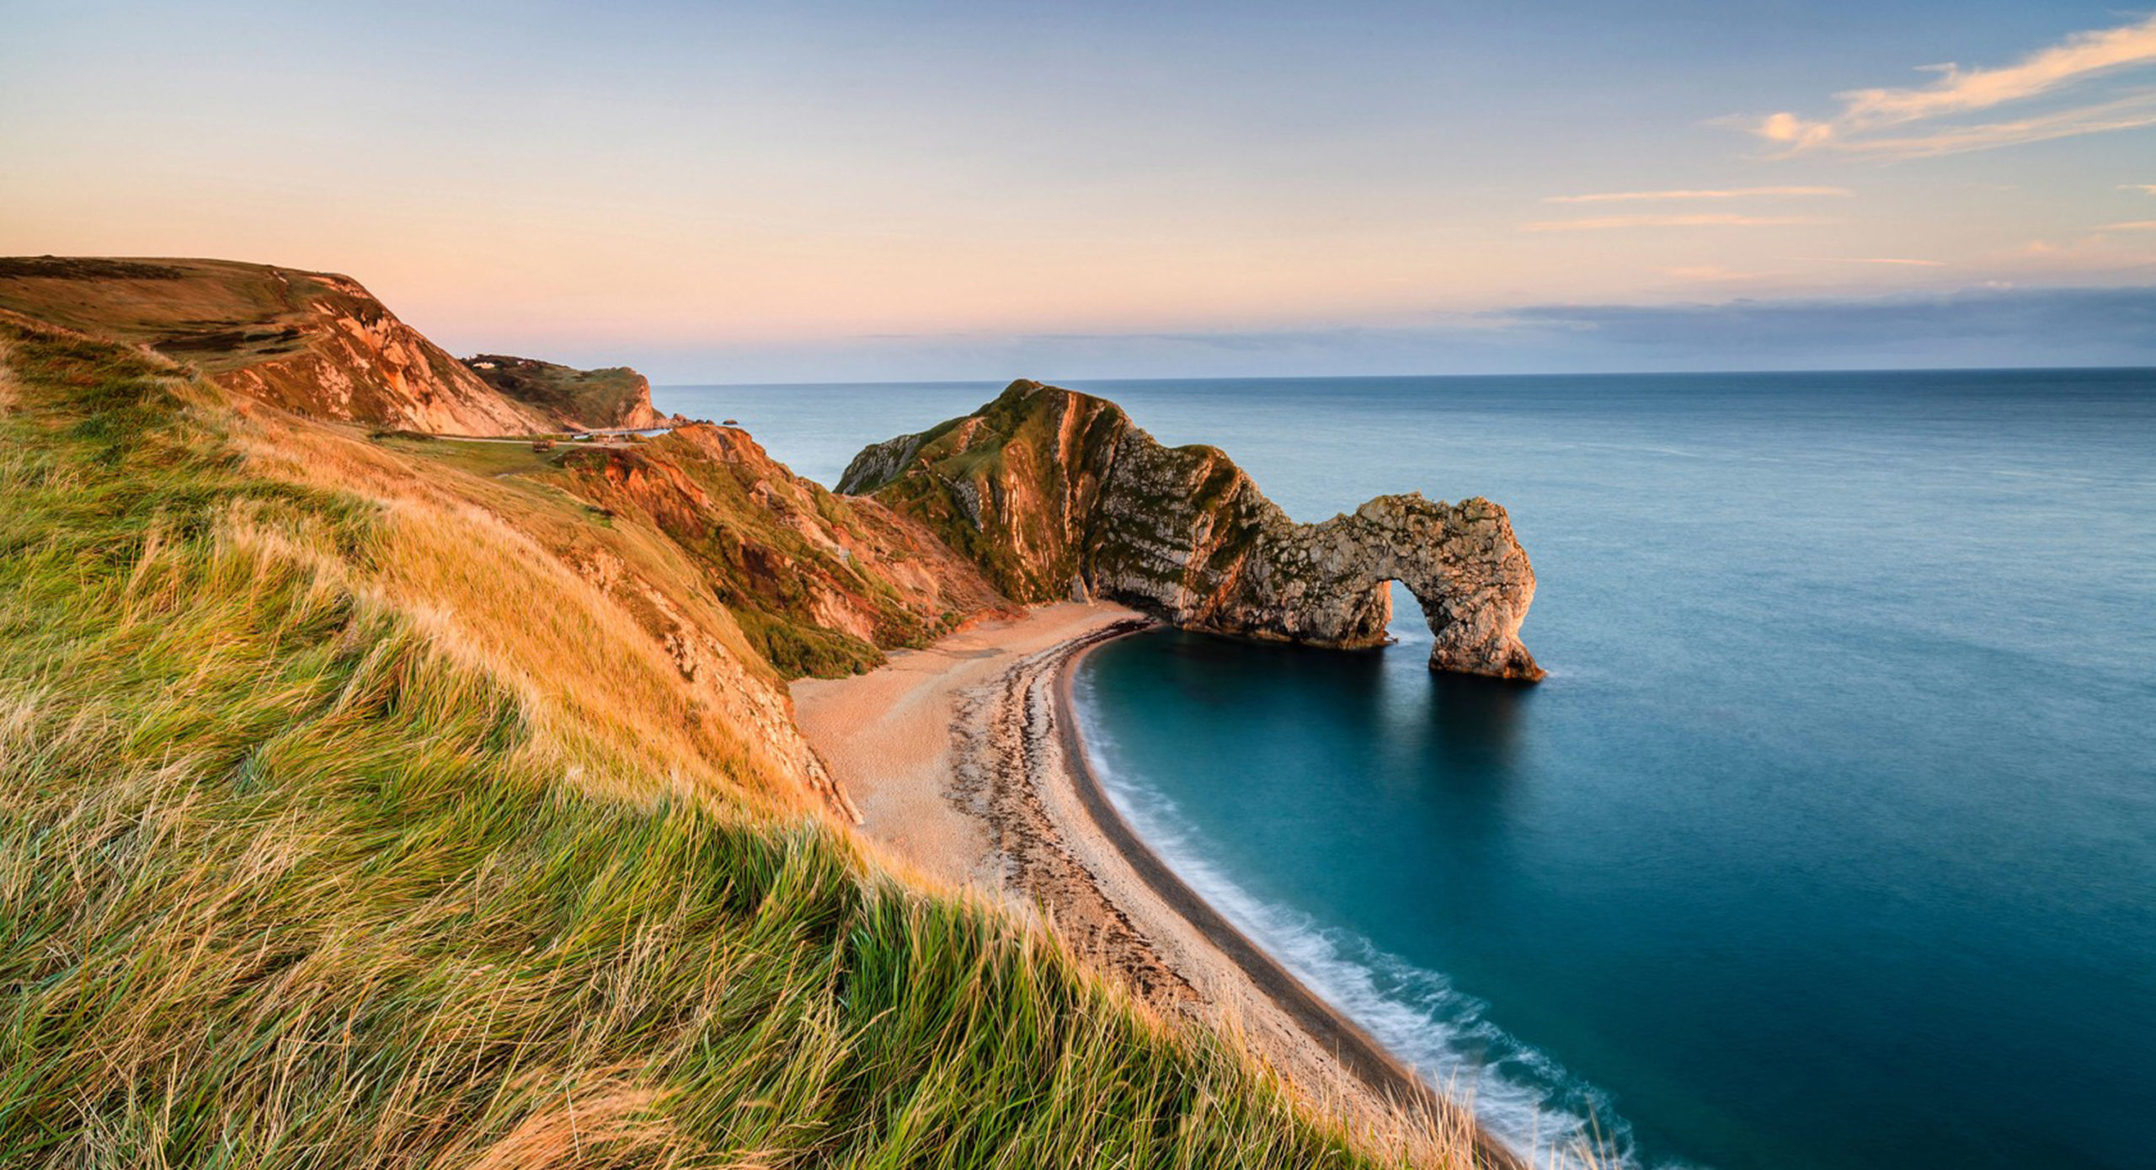
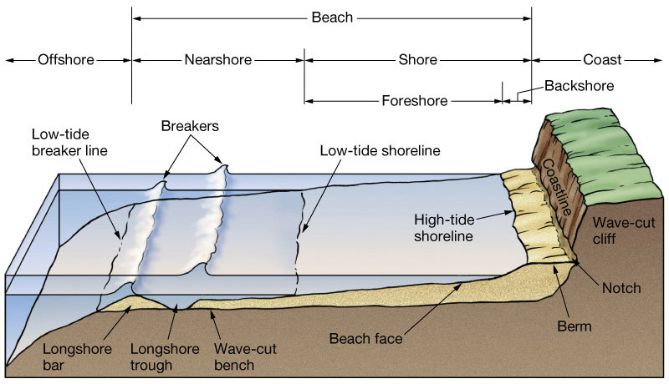
Lesson 1: WHAT IS THE COASTAL ZONE?
Independent research links
BBC Bitesize - Coastal Landforms https://www.bbc.co.uk/bitesize/guides/zmwxsbk/revision/1
Kiddle Encyclopedia - Coasts https://kids.kiddle.co/Coast
Video links
Coastlines
https://www.youtube.com/watch?v=tTYHZ7exBS0
The coastal zone is a narrow stretch between the land and the sea. The sea, land and air constantly change its shape and form.
We use the coast in many different ways, especially here in the UK as we live on an island, so the coast is all around us. Read about some of the uses of the coast on the Kiddle article and try to explain what each use means. Challenge – can you find examples of places around the UK where the coasts are used in these ways?
Use | Explain | Place example
Defence
Transport
Tourism
Settlements
Look at the diagram of the coastal zone to the right. DESCRIBE the features of the coastal zone (remember to use the labels in the diagram and SAY WHAT YOU SEE).
Now, let’s practice using diagrams to illustrate knowledge. On a separate piece of paper, DRAW a labeled diagram to illustrate the different parts of the coast from the diagram provided above. Challenge – can you suggest which human uses of the coast would happen in the different locations on the coastline diagram? Add these in a different colour on your diagram.

Slide 2
Lesson 2: WAVES AT WORK
Independent research links
BBC Bitesize KS3 – The importance of waves https://www.bbc.co.uk/bitesize/guides/zmwxsbk/revision/3
Video links
How do waves work?
https://www.youtube.com/watch?v=_LRc6k-clzE
Read the information in the first BBC Bitesize link. Complete the following sentences.
The power of waves is one of the most important forces that changes the shape of the coast. Waves are created by ______ ____________ over the surface of the sea. The size of a wave depends on: length of ________ the wind has been blowing, the ________ of the wind, and the ______ - how far the wind has travelled
Using the information from the BBC Bitesize link and the video, WRITE in the correct definition and then label the diagram below with SWASH and BACKWASH in the correct positions.
swash
backwash
Look at the two diagrams below. State three differences between a destructive and a constructive wave.

Slide 3
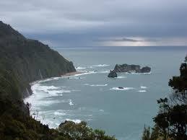
Lesson 3: EROSION and the COAST
Independent research links BBC Bitesize KS3 - Coastal processes https://bbc.in/2V5kMCi
BBC Bitesize KS3 – Types of erosion https://bbc.in/3a41GAC
Video links
Time for Geography – Four processes of erosion (GCSE video but explains it well)
https://bit.ly/2V0cN9s
Read the information in the first BBC Bitesize link. Complete the following sentences.
The is a narrow stretch between the land and the sea. The sea, land and air constantly change its shape and form. Erosion is the process by which the coastline gets worn down. There are four ways in which it happens. The UK has approximately km of coastline including cliffs, beaches, salt marshes and ports/harbours.
Using the information from the second BBC Bitesize link and the video, draw a line to link the keyword to the definition and then to the diagram.
TAKE IT FURTHER
Explain what types of landforms are created along the coastline due to erosion.
Check your understanding - Cover the diagram above and write a definition of the four ways in which the coastline is being eroded in your own words.
Keyword | Definition
Hydraulic action
Abrasion
Attrition
Solution

Slide 4
Lesson 4: DEPOSITION and the COAST
Independent research links BBC Bitesize - Coastal Landforms https://bbc.in/2XLKPQr
BBC Bitesize – Wave types https://bbc.in/3ctRToV
Video links Understanding waves https://bbc.in/34M9K8d
Depositional coastlines (up to 1 min) https://bbc.in/2RR1Chf
Longshore drift is a process of transportation that shifts eroded material along the coastline.
Prevailing wind is the most common wind direction, which for us is from the south west.
Swash is the wave that travels up the beach.
Backwash is the wave that travels back down the beach.
Read the statements below. Write the numbers 1-4 to show the order in which longshore drift happens.
 | The waves returns down the beach (backwash) with the force of gravity, drawing material back off the beach at a right angle.
 | The beach material continues to move along the beach in a zigzag motion.
 | The prevailing wind brings waves onto the beach (swash) at an angle, carrying beach material with it.
 | The beach material is picked up once again by the next wave.
In the space provided below, draw a labeled diagram to show the process of longshore drift. You can find lots of examples in a simple Google search!
Look at the your diagram. EXPLAIN in complete sentences how longshore drift happens using your diagram to support. Challenge – can you explain what landforms are created from this process?

Slide 5
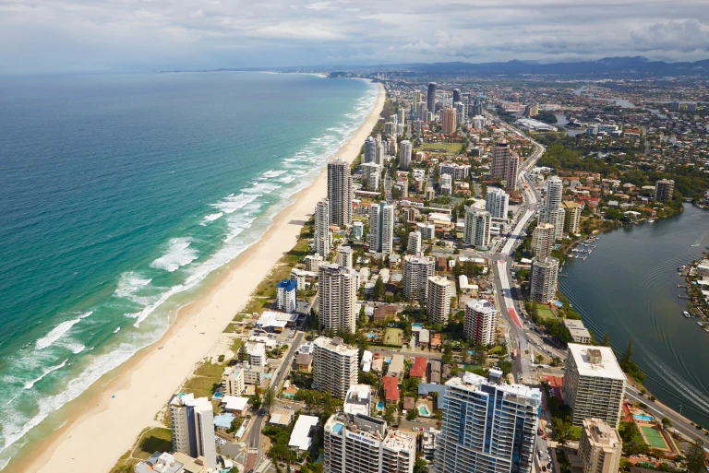
Lesson 5: MANAGING COASTS
Independent research links
BBC Bitesize - Coastal Management https://www.bbc.co.uk/bitesize/guides/z6qtyrd/revision/1
Video links
Methods to reduce coastal erosion https://www.youtube.com/watch?v=_eeKpz8oD7E
Should we protect coastlines? https://www.youtube.com/watch?v=F7xNJiU3ZgE
Hard engineering this involves building structures to protect the coast.
Soft engineering this involves working with nature by using natural materials or allowing nature to take back areas.
Read over the details on coastal management using the BBC Bitesize link and watch the video on methods to reduce coastal erosion. EXPLAIN below the advantages and disadvantages of at least 2 different types of coastal management techniques.
WATCH the video by a student in Norfolk – Should we protect our coastlines? Below, record the pros and cons of coastal management according to this student. Beneath your scales, explain what you think about coastal management techniques – should we protect our coastlines?
Judgement
Pros
Cons

Slide 6
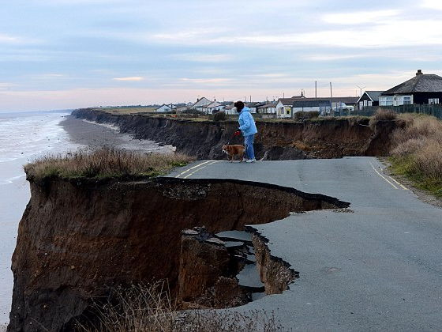
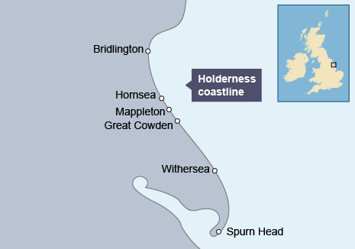
Lesson 6: THE HOLDERNESS COASTLINE
Independent research links BBC Bitesize KS3 – Holderness Case Study https://www.bbc.co.uk/bitesize/guides/z2234j6/revision/4
Video links
Holderness Case Study
https://www.youtube.com/watch?v=IXtVnzzrQU4
Read the information in the first BBC Bitesize link. Complete the following sentences.
The Holderness coastline is located on the ______ coast of England. It is the ________ eroding coastline in Europe. The coastline is rapidly eroding at an average of _______ metres a year.
Using the information from the BBC Bitesize link and the video, LABEL around the map what the problems are facing this coastline.
Check your understanding – WRITE below what has been done to manage this coastline, EXPLAIN how these techniques will help and SUGGEST how the conflict that may exist over these techniques.
Management | Why? | Conflict?

