Slide 1
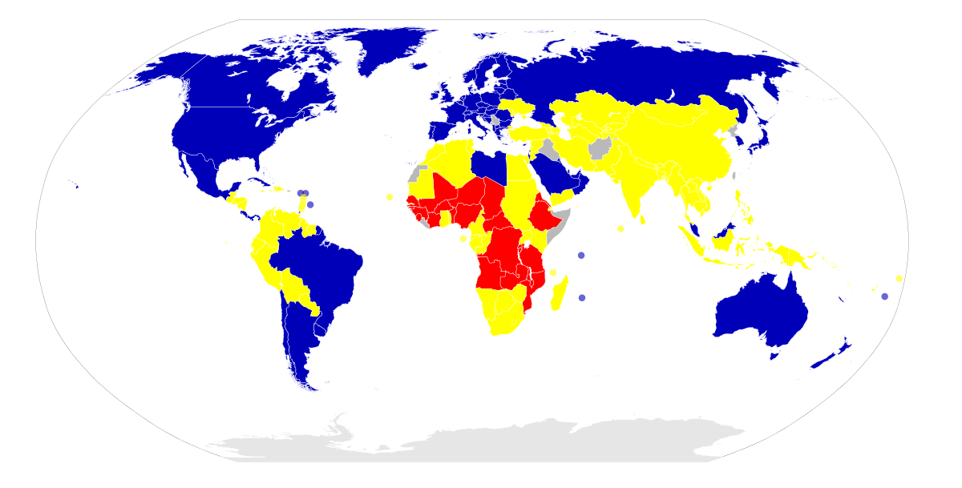
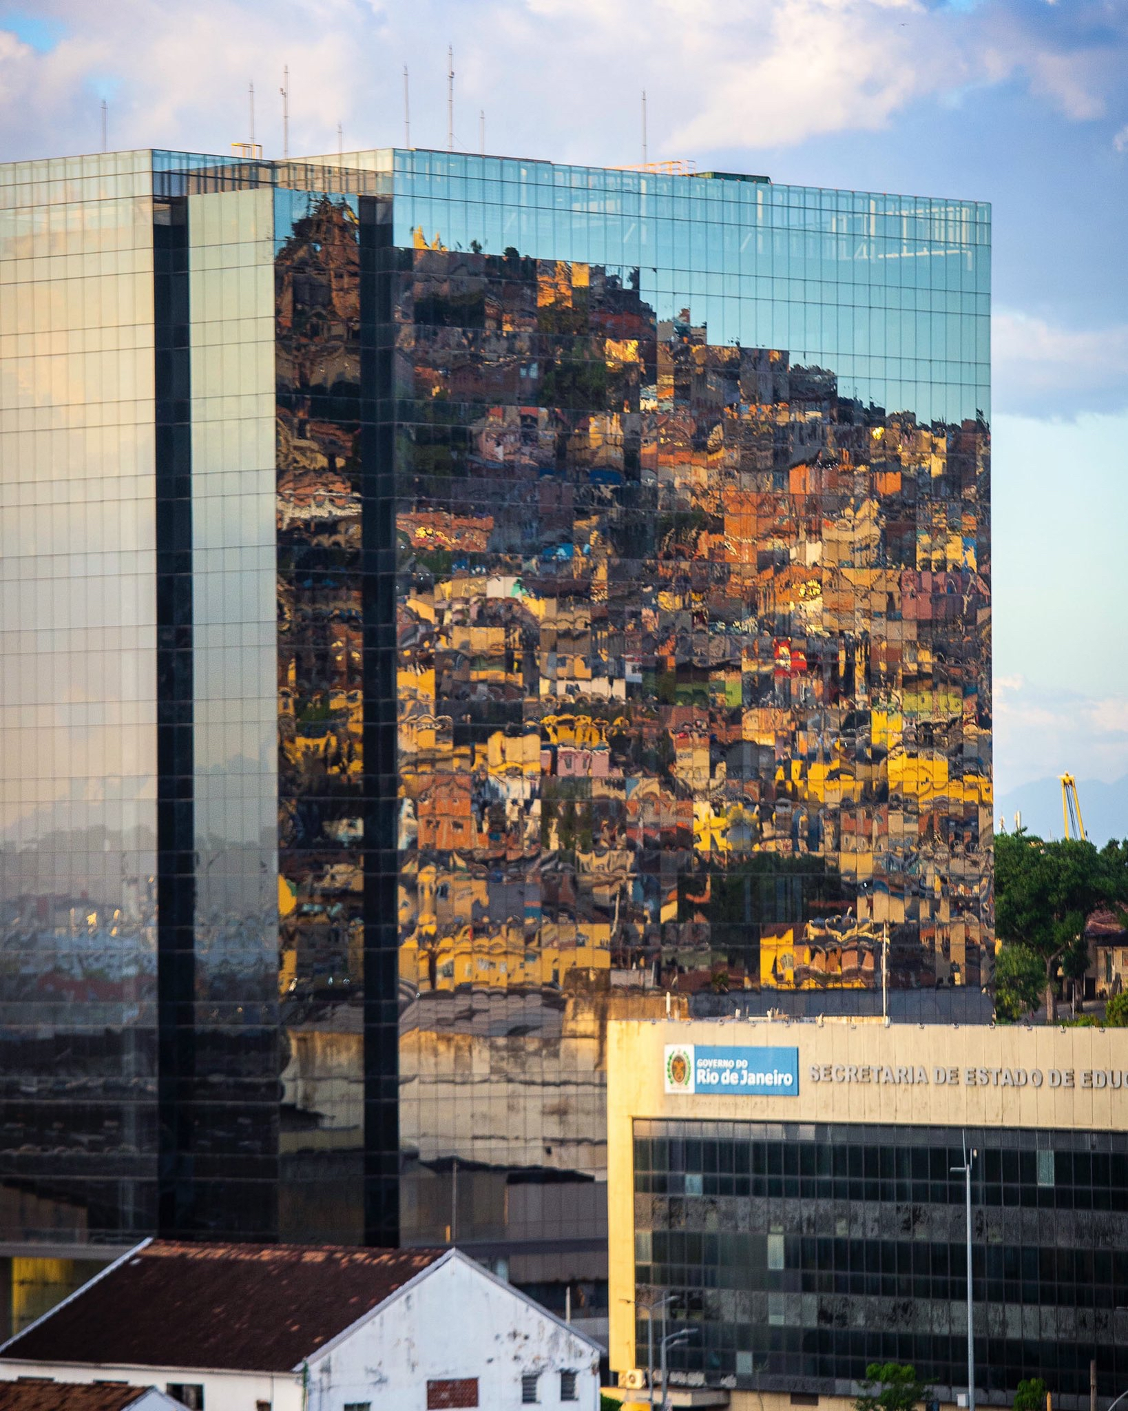
Dynamic Development - Introduction!
Lesson 1: What is development?
Task 1 – How do you think the residents feel about each other in this area?
Task 2 – Define development, in geographical terms.
Task 3 – Explain underneath each point why we would use that aspect to measure development.
Economic | Social | Environmental | Political – STRETCH
Average income | Healthcare | Access to safe water | Freedom of speech
Type of employment (what types of jobs to people work in) | Education | Waste management | Corruption levels

Slide 2
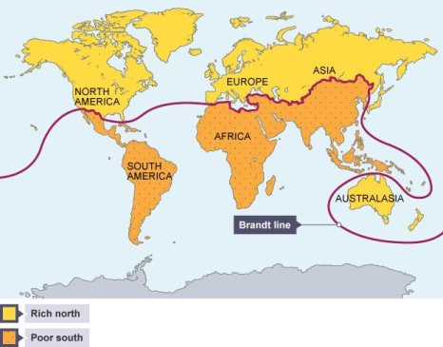
Dynamic Development - Introduction!
Lesson 1: What is development?
Task 4 – Why do we use lots of different measures of development? What is the issue with just using one measure?
HIC – High income country: these are developed countries which have lots of money, many services and a high standard of living.
NIC – Newly industrialised country: These are emerging countries which are rapidly developing but are not quite HICs yet.
LIC – Low income country: these are developing countries which are often poor, with fewer services and a lower standard of living.
Task 5 – Give examples for each type of country.
HIC | NIC | LIC
Task 6 – Looking at the Brandt line map, explain what the issues are with it.

Slide 3
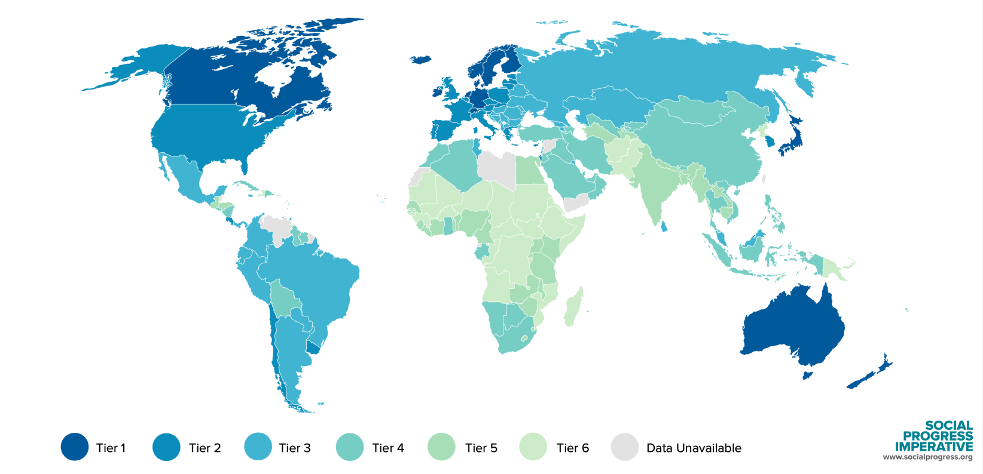
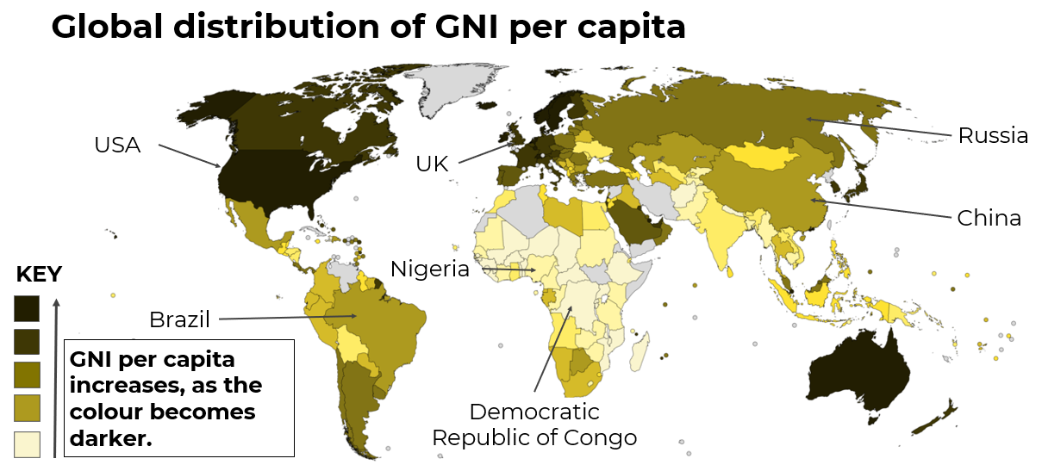
Measuring Development
Lesson 2: How do we measure development?
Task 1 – Define Gross national Income (GNI) per capita.
Task 2 – Use the map below to answer the questions.
Which country has the highest GNI?
Which country has a higher GNI, China or Russia?
Which country has the lowest GNI?
Task 3 – Describe what type of work each job sector involves.
Sector | Definition | Examples of industry
Primary
Secondary
Tertiary
Quaternary

Slide 4
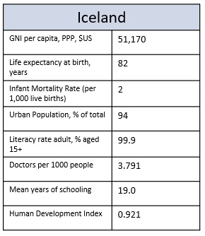
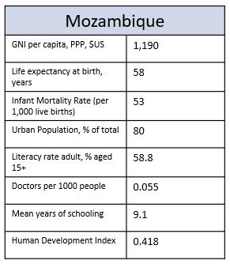
Measuring Development
Lesson 2: How do we measure development?
Life expectancy: the average number of years a person is expected to live in a particular place.
Infant mortality rate: the number of children who die before the age of 1.
Literacy rate: the percentage of people who can read and write.
Doctors per 1000: the number of doctors employed per 1000 people living in the country.
Task 4 – Complete the table – would you expect the country stated to have a high or low value for that indicator?
Country | Life expectancy | Infant mortality rate | Literacy rate | Doctors per 1000
China
Nigeria
Democratic Republic of Congo
USA
Brazil
UK
Russia
STRETCH – Why do you think some of these countries will have a high or low value for some of these indicators? Explain below.
Task 6 – Which country is the HIC and which is the LIC? Why do you think this?
Task 5 – Complete the Top Trumps cards for Iceland and Mozambique.

Slide 5
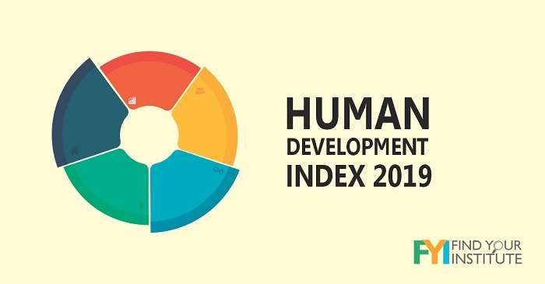
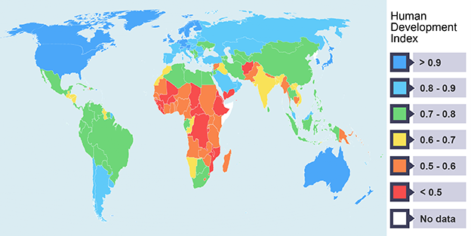
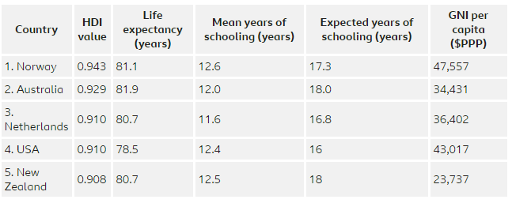
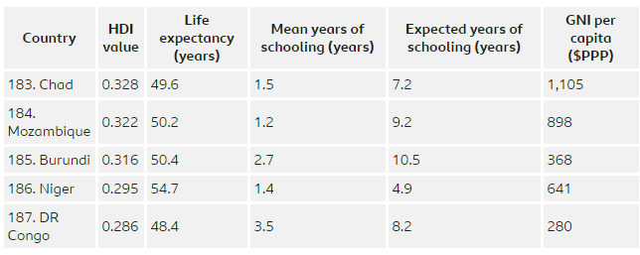
Lesson 3: What is the Human Development Index?
Task 1 – What is the human Development Index (HDI)?
Task 2 – Describe the pattern of HDI across the world.
Task 3 –What is the most important measurement included in the HDI? Why do you think this?

Slide 6
Lesson 3: What is the Human Development Index?
Task 4 – Positive and negative aspects of HDI.
Positives | Negatives
Task 5 – Is HDI still a useful measure of development?

Slide 7
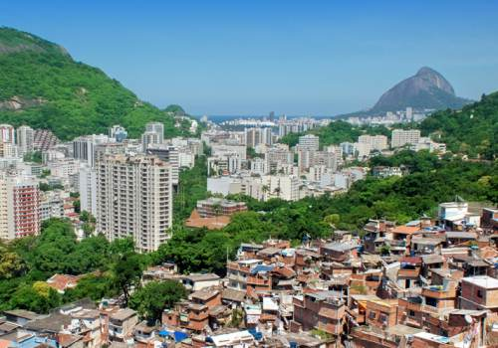
Lesson 4: What does inequality of development look like?
Global Inequality
Task 1 – What new key terms can you remember?
Key terms
Task 2 – Watching the video, write down as many key facts as you can. You will need these for the next tasks.
Task 3 –What are the most important things you have learned about inequality form the video? Was there anything that shocked you?
I have learned from the documentary that

Slide 8
Lesson 4: What does inequality of development look like?
Global Inequality
Task 4 – How did the documentary make you feel about unequal development? Why do you feel this way? What do you think we should do?
After watching the documentary, I felt
Task 5 – Pierre Simmons says that “inequality can never be a good thing”. Do you agree with him? Explain your answer. Remember to use data and key terms to support your view.

Slide 9
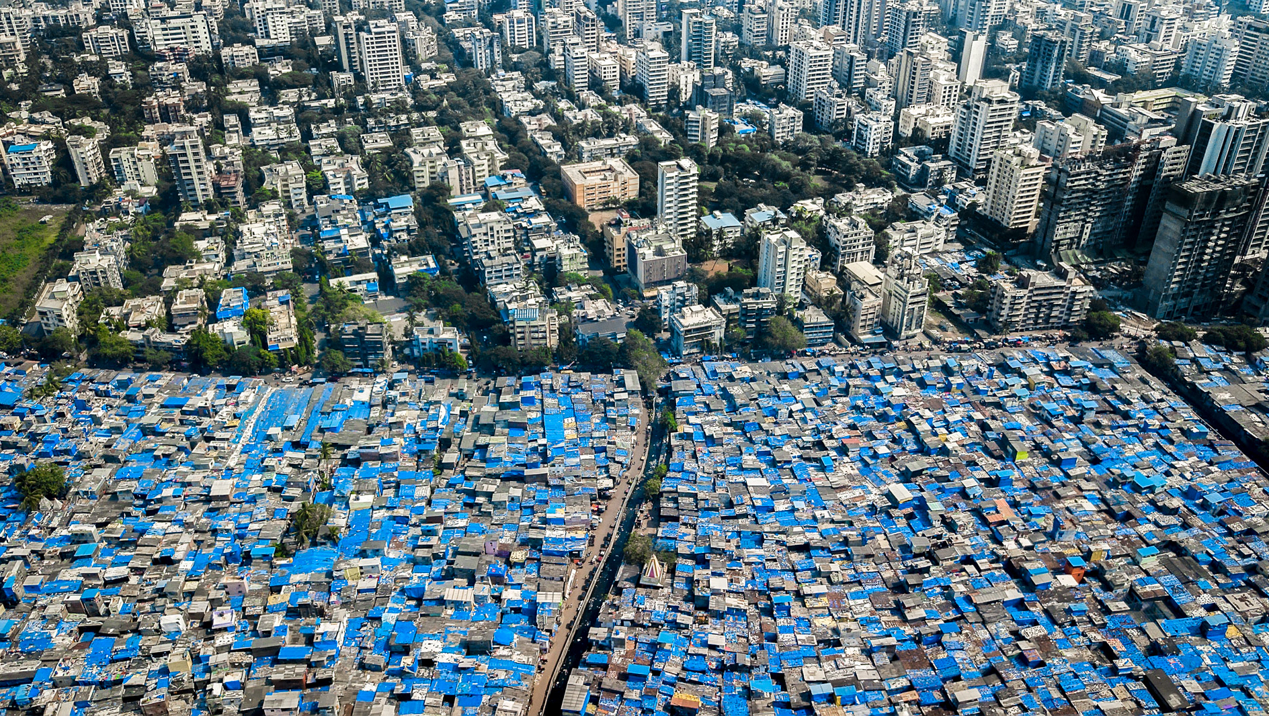
Lesson 5: What are the causes of uneven development?
Uneven Development
Task 1 – What are the causes of uneven development?
Causes
Task 2 – These are some of the reasons for causes of uneven development. Categorise them into: physical, historical/political or social reasons. Remember to give yourself a key if you are colour coding them.
Discrimination
Climate
Population
Location
Trade
War
Corruption
Natural hazards
Natural resources
Task 3 –Complete the table – explain how each aspect in the table can lead to unequal development around the world. STRETCH: Include any specific countries that these aspects might impact.
Physical | Historical/Political | Social
Natural disasters: | Stable and honest leaders: | Overpopulation:
Landlocked: | War and conflict: | Fewer opportunities:
Disease (e.g. malaria): | Global trade: | Level of education:

Slide 10
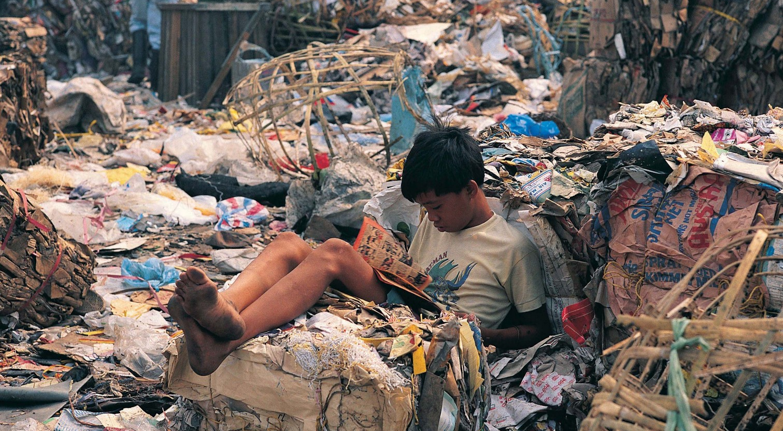
Lesson 5: What are the causes of uneven development?
Uneven Development
Task 4 – True of false? Complete the quiz for the statements below.
Location is a social cause of uneven development. T or F
War uses up resources and makes it difficult to produce goods and trade. T or F
When a country’s population is greater than its resources, it is called overpopulation. T or F
Climate is a physical cause of uneven development. T or F
Natural hazards are a social cause of uneven development. T or F
Task 5 – ‘A day in the life of…’ 1. What do you think this boy’s life is like? 2. How is it different to your life? 3. Why do you think he has ended up in his current situation?

