Slide 1
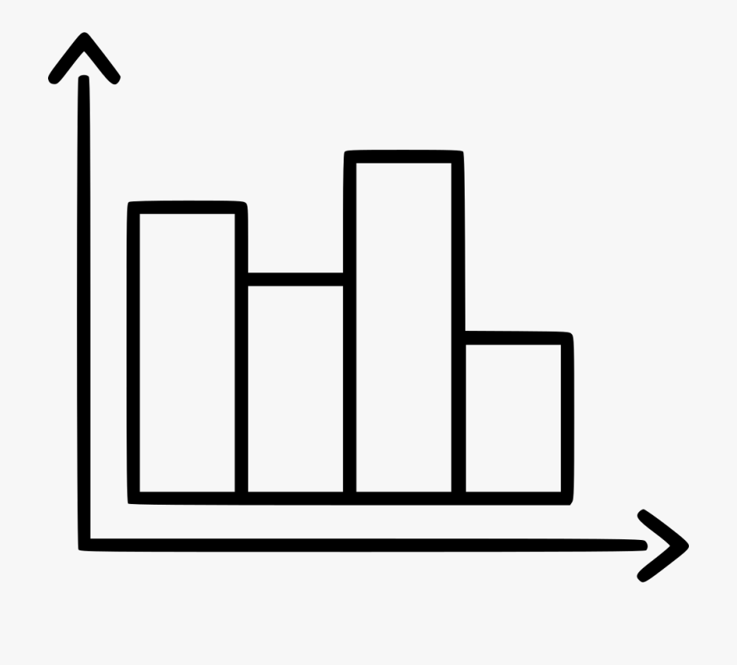
Incredible India - Introduction!
Lesson 1: Where in the world is India and what do we already know?
Independent research links
Video links
Maps:
PDF https://bit.ly/3jkzlLi
PPT https://bit.ly/3ljNri5
Google Earth: https://bit.ly/3hzKRSz
Introducing India: https://www.youtube.com/watch?v=q3iy6MhQNgI
Task 1 & 2- Use your own knowledge to create a mind map showing what you already know about India. Now watch the Introducing India video and add any more information in a different colour.
Task 3- Using the link to the maps, write a geographical description of the location of India.
Task 4- Looking at the results of the questionnaire, what 2 questions have you chosen to research? Were the majority of people questioned correct or not?
Task 5- Now you have chosen your 2 questions, you must draw 2 DIFFERENT types of graphs to present the data.
Graph 1:
Graph 2:
Task 6- Using your graphs you have completed above, describe and explain people’s general knowledge of India. Is it correct? Why do you think this is the case?

Slide 2
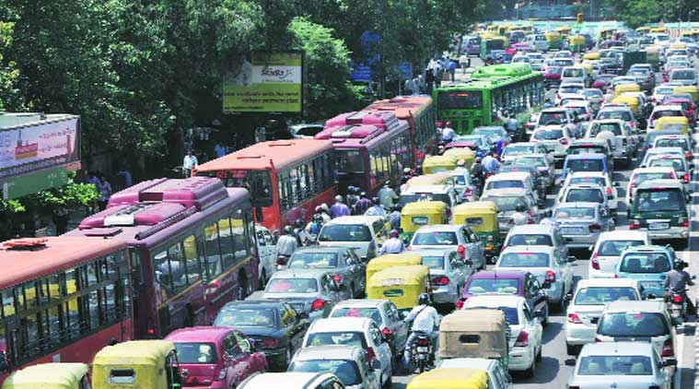
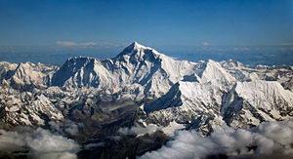
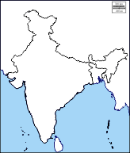
Human and physical features
Lesson 2: What are the human and physical features of India?
Independent research links
Video links
3D Geography – India: https://www.3dgeography.co.uk/geography-of-india
Google Earth: https://bit.ly/3hzKRSz
Human & physical features: https://bit.ly/2YEznFT
Physical Geography is about the Earth’s natural features (mountains, weather, rivers, etc.)
Human Geography is about how human activity affects or is influenced by the earth’s surface (cities, roads etc.)
Task 1: Using the links above, complete the below table with all the human and physical features you can spot in India.
Human Features | Physical Features
Task 2 & 3: Using the maps, complete your own map with the human and physical features listed.
Physical:
Himalayas, Thar desert, River Ganges, Bay of Bengal, Indian Ocean, The Godavari River, The Mahanadi River, The Arabian Sea
Human:
Use a red dot to locate and label the major cities: New Delhi, Kolkata, Mumbai, Bangalore, Bhopal, Srinagar, Chennai
Task 4: Using the map you have just created, you must describe AND explain why these features are found where they are.

Slide 3
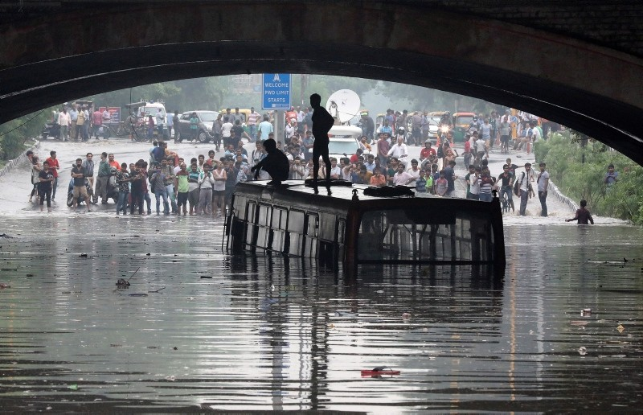
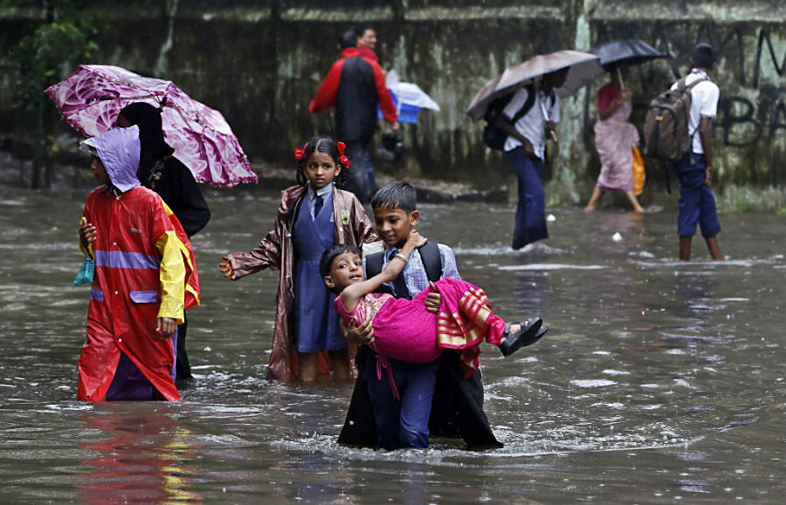
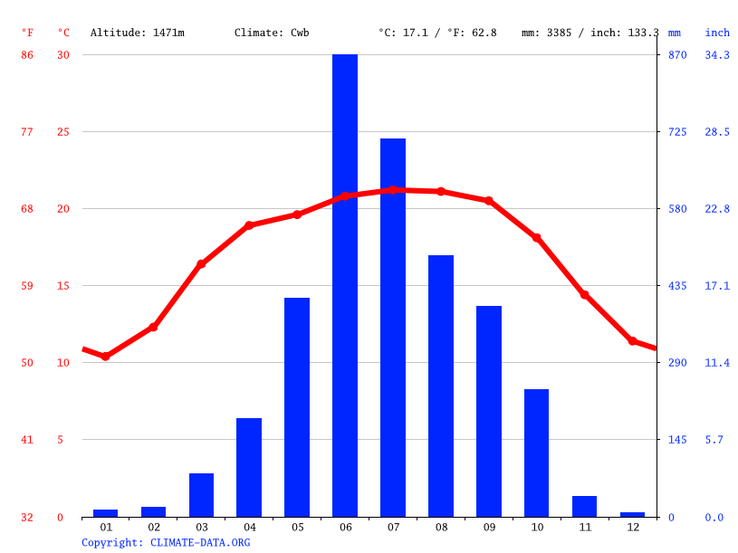
The Monsoon Season
Lesson 3: What is the Monsoon Season and how does it impact India?
Independent research links
Video links
The Monsoon:
https://bit.ly/31yFy0j
The Monsoon: https://www.youtube.com/watch?v=s1nRsGcQSJY
Task 1 – Watch the video clip on the Monsoon and answer the following questions. You will need to pause as you go through to write down the answers!
What reaches the northern hemisphere in May/June?
Where is the monsoon centred?
Which part of India is Udaipur in?
What month do temperatures start to rise?
What month does monsoon season start?
What is the big difference between the land ad the sea that causes the monsoon to start?
What happens to air when it heats up?
What do the monsoon winds carry in land?
How much of India’s rain arrives during this season?
How far does the monsoon system spread?
Task 2- Using the climate graph, complete the data table for Shillong, India.
Task 3- Impacts of the monsoon season.
 | J | F | M | A | M | J | J | A | S | O | N | D
Temp (*c)
Rainfall (mm)
Plenary - What is the most significant impact? Why?

Slide 4
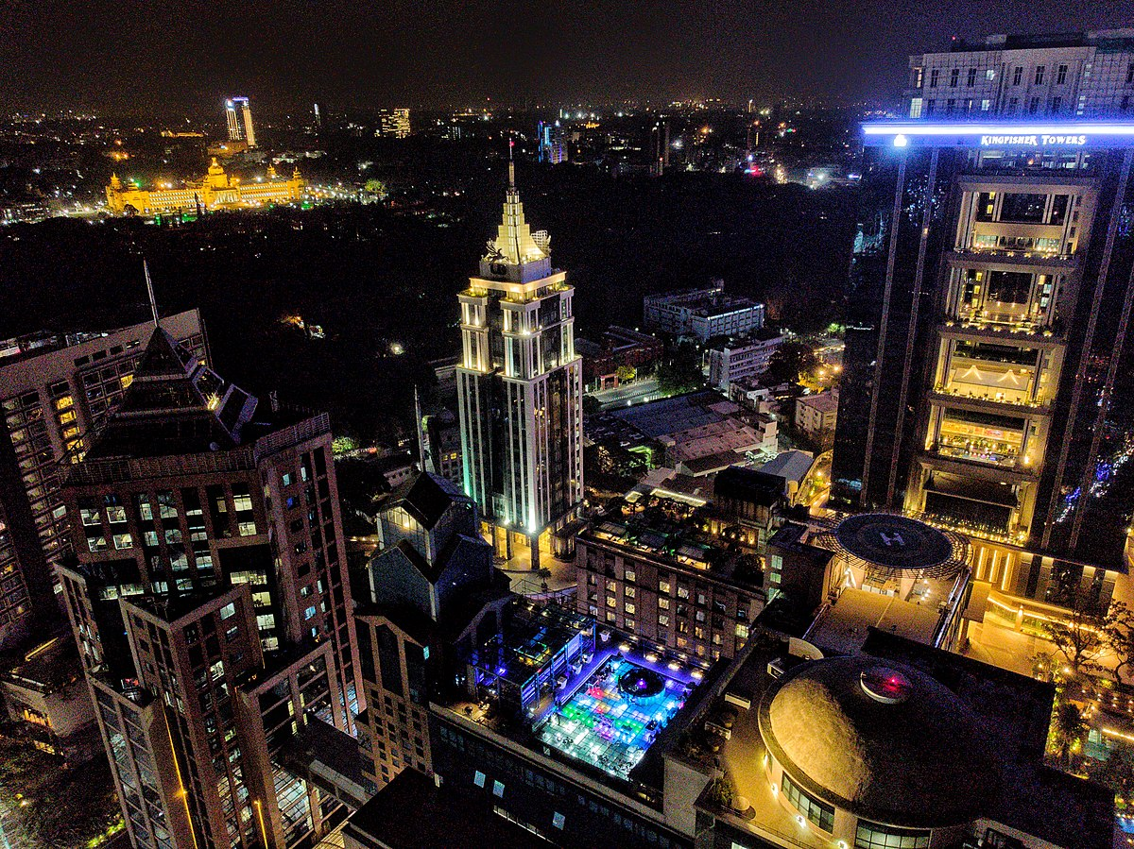
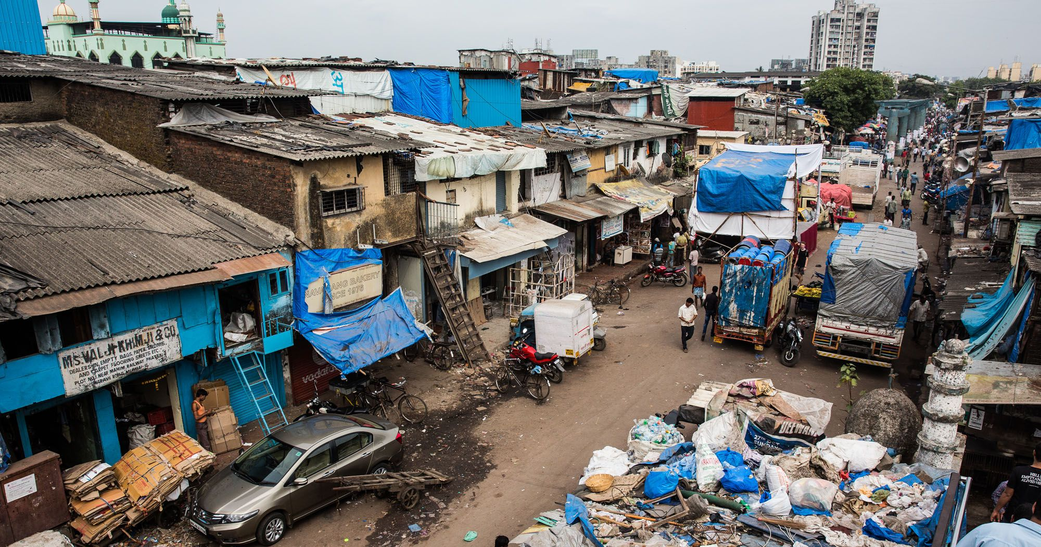
Globalisation in India
Lesson 4: Has globalisation been positive or negative for India?
Video links
Globalisation:
https://www.youtube.com/watch?v=ZNejKHKSbl0
Task 1 – What is your definition of globalisation?
Task 2 – Using the interviews, complete the following table.
Individual | Positive impacts of globalisation | Negative impacts of globalisation
Hotel manager
Call centre supervisor
Steel fixer
Property developer
Taxi driver
Task 3: Use the washing to put the people in order from most to least happy.
Why have you put them in this order? Justify your answer with facts!
Most happy
Least happy
Task 4 – Overall, do you think globalisation is a positive or a negative thing for India? You must give evidence to justify your answer.

Slide 5
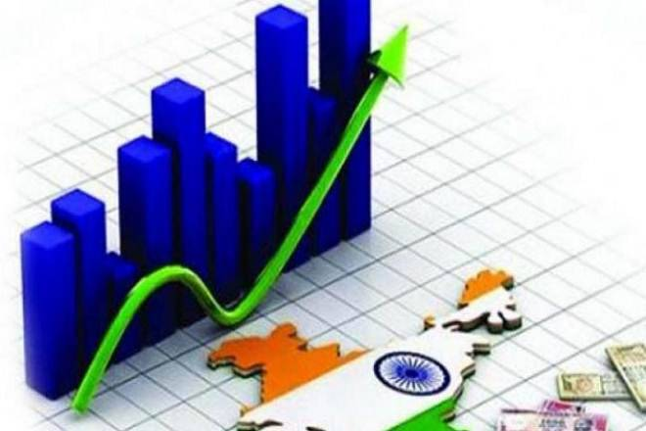
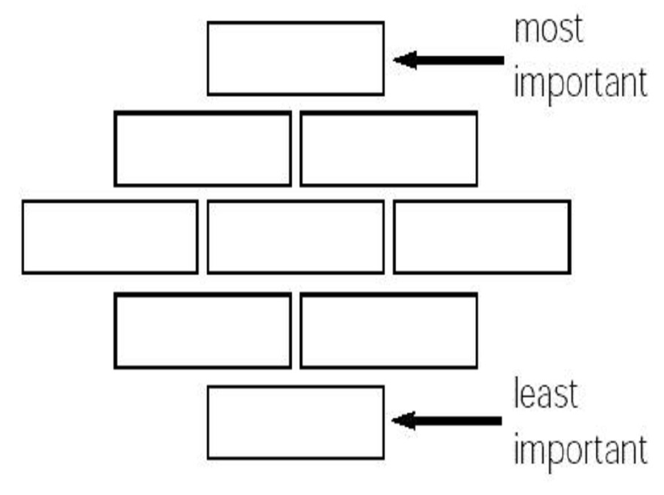
India’s global importance
Lesson 5: How has globalisation impacted India’s importance in the world?
Video links
India’s importance: https://www.youtube.com/watch?v=zD4-a186x64
Task 1 – Why is India increasing in importance within the world? Mind map here!
Task 2 – Categorise the following statements:
India has signed many international treaties or agreements to make the world safer. It is the world’s second largest contributor to UN peace keeping forces with 10,000 troops.
Millions of tourists visit India for its scenery, food, spirituality and more. In 2006, more than 150,000 medical tourists who flew in for lipo-suction and open heart surgery for a fraction of what they would pay at home.
6.2million Indian tourists holiday abroad every year. This is increasing by 15% annually. 700,000 visited the UK in 2006
Hundreds of foreign companies have set up outsourcing centres in India. 30 major firms from Lloyds TSB to Virgin Trains use Indian call-centres.
India buys goods and services from other countries. Gucci, Chanel and Giorgio Armani fashion imports are rising by 11% a year.
The success of hi-tech industries has seen large numbers of Indians return, in what is being called the ‘brain gain’
Millions of Indians live in other countries. 2.5 million live in the US. One in nine Indian Americans is a millionaire – that’s 10% of America’s millionaires..
India sells goods and services to other countries. Its firms spent over $7billion buying-out foreign companies in 2006.
MNC (Multi-national company): A company that has businesses in many different locations across the globe.
A Multinational company is recognised everywhere around the world e.g. McDonald’s, Nike, Apple
Task 3 – How are MNCs appealing to their customers in India?
Task 4 – How is India attracting international business? Once you have categorized your points, use them to create a diamond 9 below.
Task 5 – See separate PDF or Word Document for impacts of globalisation task.
Plenary - What is the most important factor contributing to India’s growing success? Why?

Slide 6
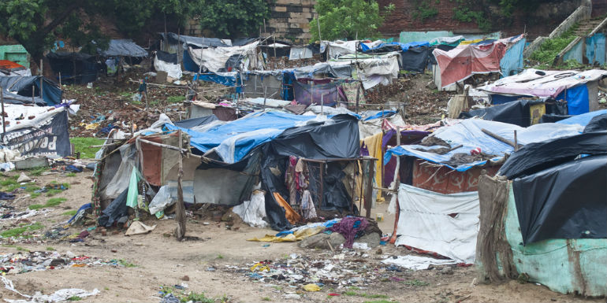
Future challenges
Lesson 6: What future challenges does India face?
Video links
Rural to urban migration: https://www.youtube.com/watch?v=FXmOJ-fYMyc
Kevin McCloud: Slumming It (Episode 1): https://www.youtube.com/watch?v=Im0tHRs9Bng
Task 1 – Describe and explain the changes in the Indian population since 1950.
Task 2 – Mind map the impacts of this population change.
Rural to urban migration is the movement of people from the countryside to the city areas of a particular country.
Task 3 – Watch the video and then explain what issues arise from mass rural to urban migration.
Task 4 – Time to focus on Mumbai – write a geographical description of where in India Mumbai is situated.
The formal economy has workers that have legally binding contracts, regulations in the work place and pay tax to the government, for example, office workers, police officers, teachers.
The informal economy is often low pay, no regulations of security, contract and do not pay any tax to the government. These people are often self-employed, for example, street venders and traders working within a slum area.
Task 5 – Watch the video and then explain what some of the main issues are about living in the slum area.
Plenary - What is your opinion on the slum? What is their quality of life like? Think about it from their perspective rather than your own. Do you think the slum is a problem? If you do, who is the slum a problem for?

