Slide 1
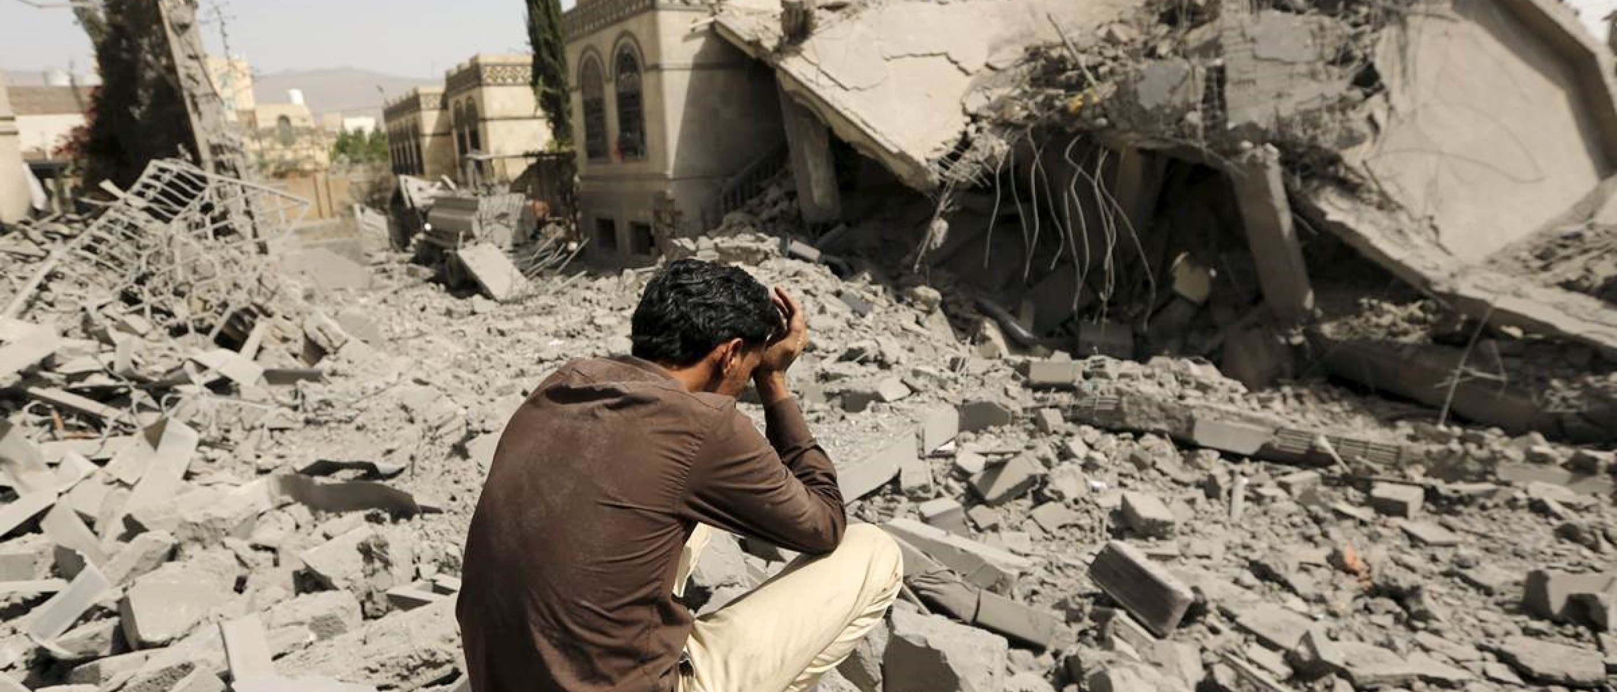
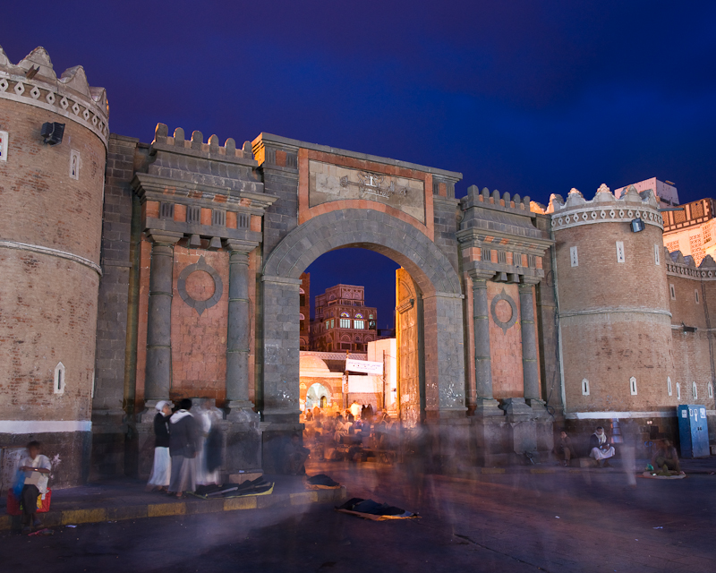
Lesson 4: Why is there conflict in Yemen and what are the impacts on the country?
Conflict in Yemen
Task 1 – What are your first impressions of Yemen?
Task 2 – Yemen fact file.
Task 3 – How does Yemen compare to the UK? Why do you think this is the case?
Capital:
Official language:
Population:
GDP (nominal):
HDI:
% of people under 15:
Life expectancy:
Task 4 – Why has conflict happened in Yemen?
What do you the UN describe the situation as?
When did the conflict first emerge?
Why was Ali Abdullah Saleh criticised?
How many regions did the proposal want to split Yemen into?
Who did the Houthis turn to, to help their cause?
What were some of the non-military zones that were targeted?
Who admitted to killing Saleh?
In 2017, what was the death toll claimed by the UN?
How many people have been displaced?
Do you think we will ever see an end to this conflict?

Slide 2
Lesson 4: Why is there conflict in Yemen and what are the impacts on the country?
Conflict in Yemen
Task 5 – Impacts of the conflict in Yemen.
Impacts
Task 6 – How are the UK and the USA involved in the area?
Task 7 – Briefing to the Foreign Secretary
Task 8 – Do you agree with how the UK has proceeded? Remember you must use evidence to justify your decision.

Slide 3
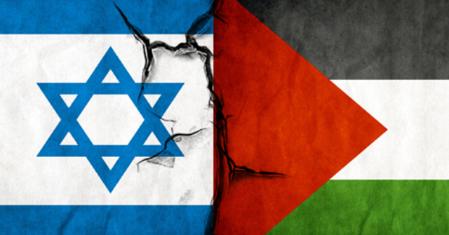
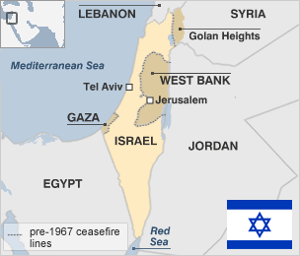
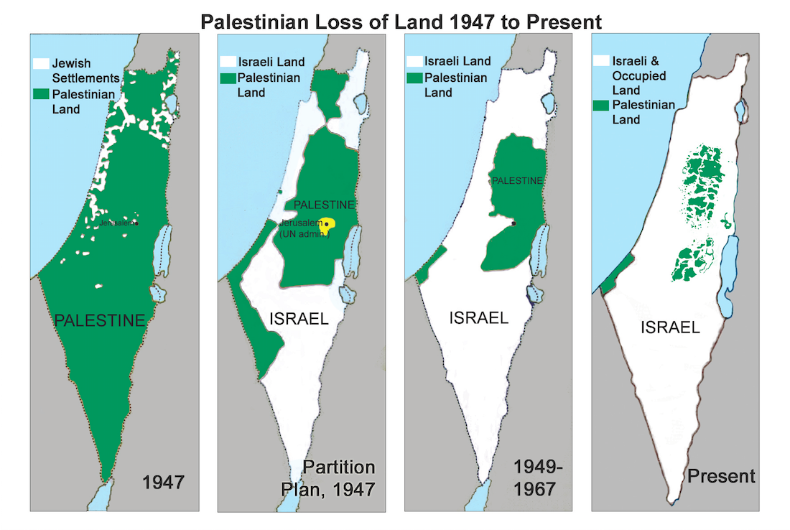
Lesson 5: Why has there been conflict between Israel and Palestine?
Israel vs. Palestine
Task 1 – Write a geographical description of the location of Israel.
Task 2 – Describe what has happened to the size and location of Palestinian and Israeli land.
Task 3 – Watch the video and answer the following questions.
What empire was Israel/Palestine under?
What was the name of the movement the Jewish people joined in Europe?
Which empires carved up the Middle East after WW1?
Who devised a plan to split British Palestine into 2 separate states?
Who won the war that was declared by the Palestinian Arabs?
How many descendants are there today of Palestinian refugees?
7. Who did Israel give Sinai back to in the 1970s?
8. Why did Jewish settlements begin to appear in Gaza and the West Bank?
9. When did the First Intifada take place?
10. When were the Oslo Accords signed?
11. When did the Second Intifada take place?
12. What did unemployment rise to in Gaza?

Slide 4
Lesson 5: Why has there been conflict between Israel and Palestine?
Israel vs. Palestine
Task 4 – Write a letter to the director general of the UN about what should happen within the area.
Mr. A. Guterres
Headquarters of the United Nations
760 United Nations Plaza,
Manhattan,
New York City,
(10017-6818)
United States
March 2021
Dear Mr. Guterres,

Slide 5
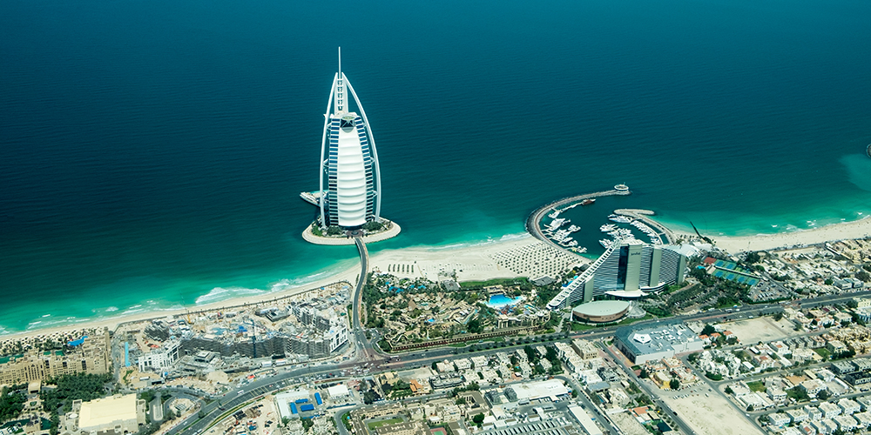
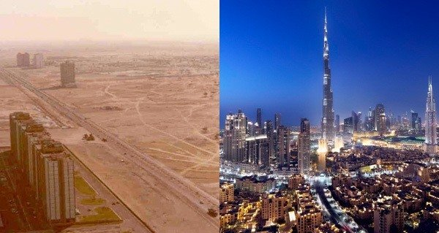
Lesson 6: Why is the Middle East such a popular tourist destination?
Tourism in the Middle East
Task 1 – How have cities such as Dubai changed in the last 30 years?
Task 2 – Travel Man documentary. Complete the tasks as you watch.
Accommodation: What is it like? How much does it cost? What are some of the main features of the hotel?
Attractions: What are some of the main attractions for tourists to do while they are in Dubai? How much do these activities cost?
What attractions surprised you? Is there anything you would particularly like to have a go at? Is there anything you would be less keen on trying? Think about where they have visited, how the travelled around etc.

Slide 6
Lesson 6: Why is the Middle East such a popular tourist destination?
Tourism in the Middle East
Task 3 – 48 hours in Dubai. Remember to include places to stay, activities to complete and timings for your trip.
Day 1:
Day 2:

Slide 7
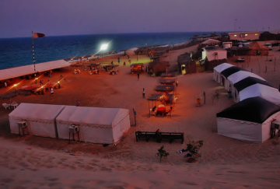
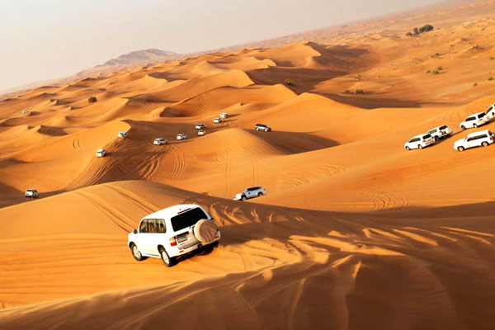
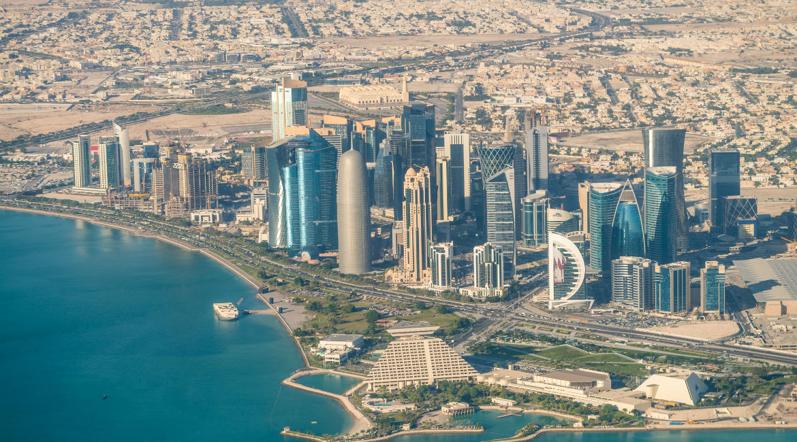
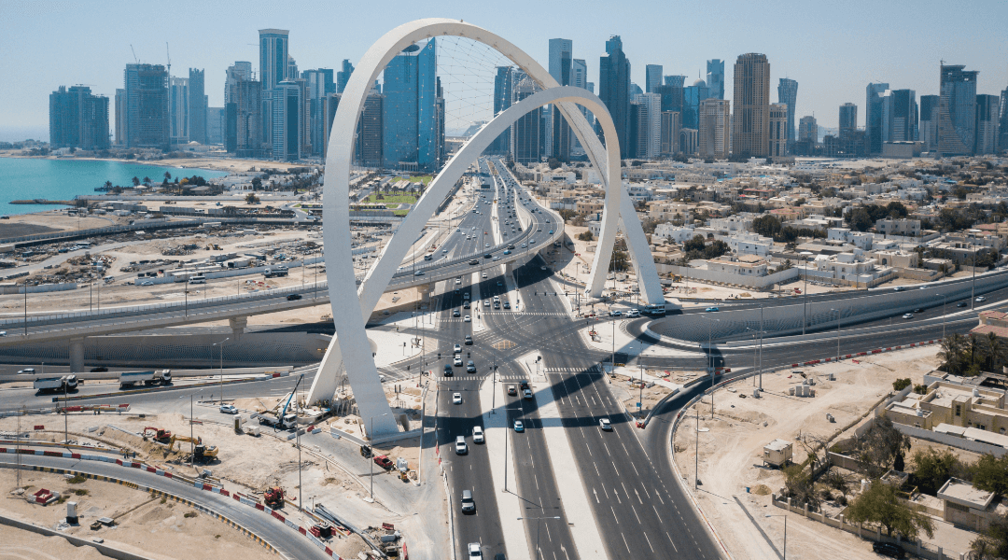
Lesson 7: Is Qatar a sustainable choice for the 2022 World Cup?
Task 1 – What would be the positives and negatives of holding the World Cup here?
Task 2 – Summary of the article on migrant workers.
Aim to write to words per line – this will give you 100 words

Slide 8
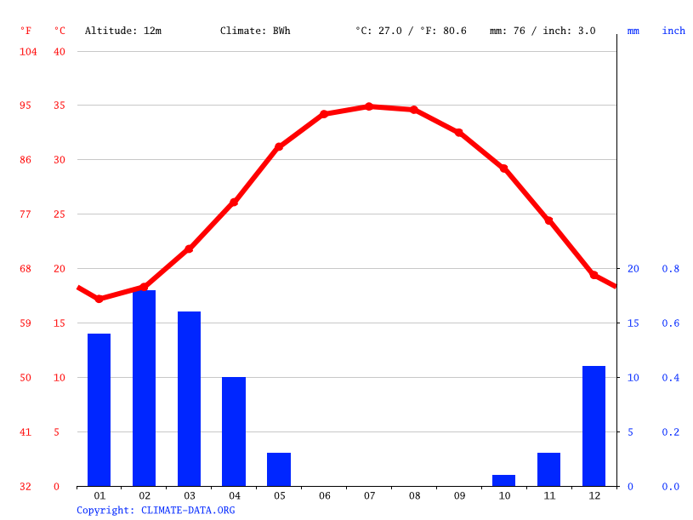
Lesson 7: Is Qatar a sustainable choice for the 2022 World Cup?
Task 3 – Use the climate graph and the bullet points to suggest some of the impacts of holding the World Cup here.
• Average daily highs in July in Qatar are around 41.5ºC.
• If the human body heats up to 39-40ºC, the brain tells the muscles to slow down and fatigue sets in. At 40-41ºC, heat exhaustion is likely - and above 41ºC, the body starts to shut down. (BBC)
• The World Cup may be played in winter instead (Nov/Dec), but this would disrupt the football seasons in Europe.
• Average daily max temperature increase by 2022 due to climate change : +1.5ºC (NASA)
Task 4 – What are the main DOs and DON’Ts for those visiting Qatar?

Slide 9
Lesson 7: Is Qatar a sustainable choice for the 2022 World Cup?
Task 5 – What is your Overall opinion, is Qatar a sustainable option?
Mr. G. Infantino
Fédération Internationale de Football Association
FIFA-Strasse 20 P.O. Box 8044
Zurich
Switzerland
March 2021
Dear Mr. Infantino,

Slide 10
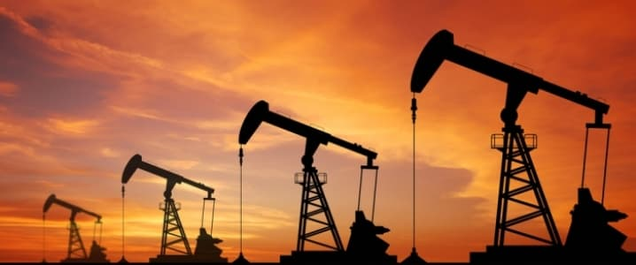
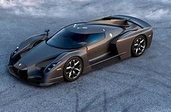
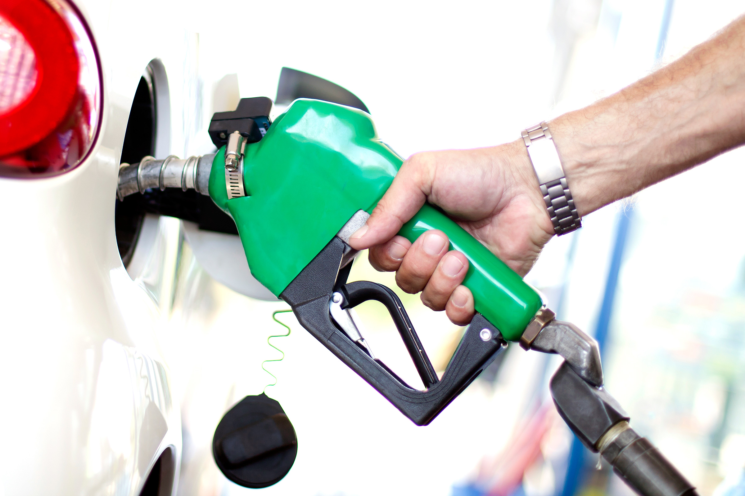
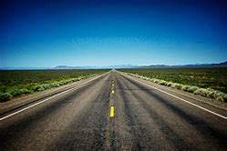
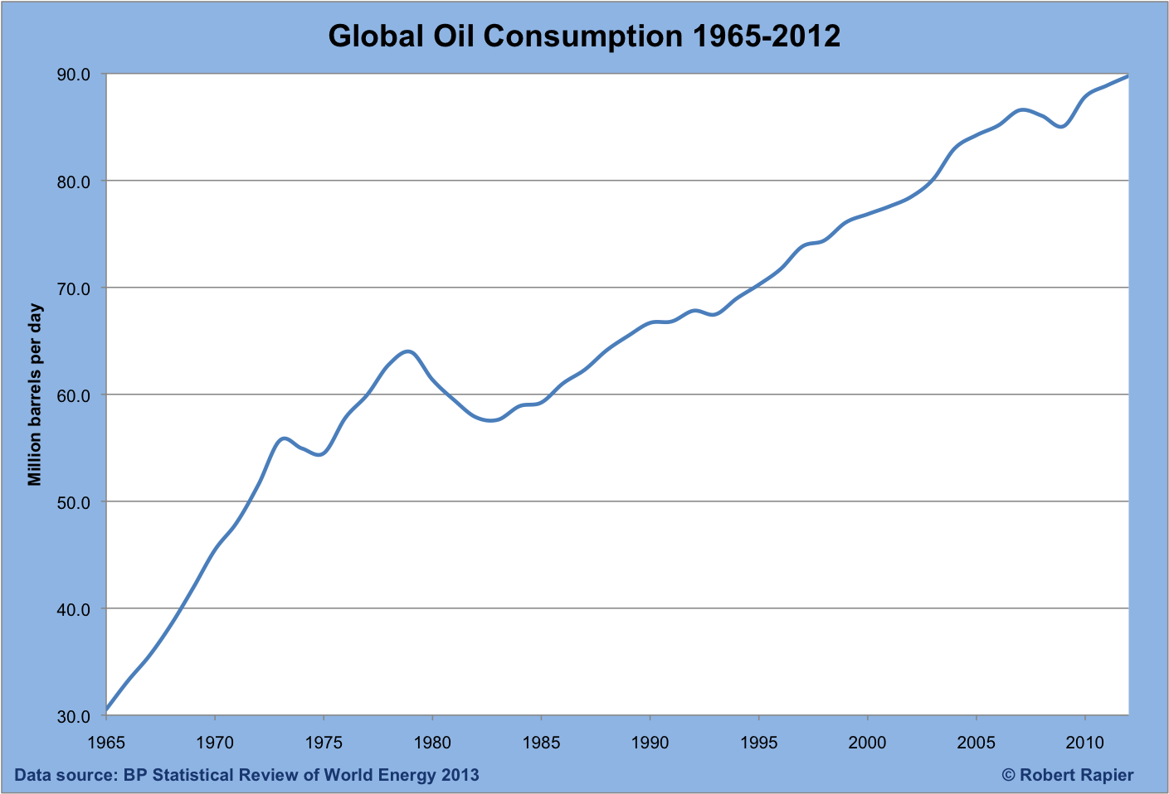
Lesson 8: Why has oil produced so much contention in the Middle East?
Oil in the Middle East
Task 1 – What do all of these images have in common? Write your answer underneath!
Answer:
Task 2 – Describe what has happened to the size and location of Palestinian and Israeli land.
B – beginning. What is happening at the beginning of the graph?
E – end. What is happening at the end of the graph?
T – trend. What is the general trend on the graph? Increase? Decrease?
A – anomaly. Is there anything on the graph that stands out from the general pattern?

Slide 11
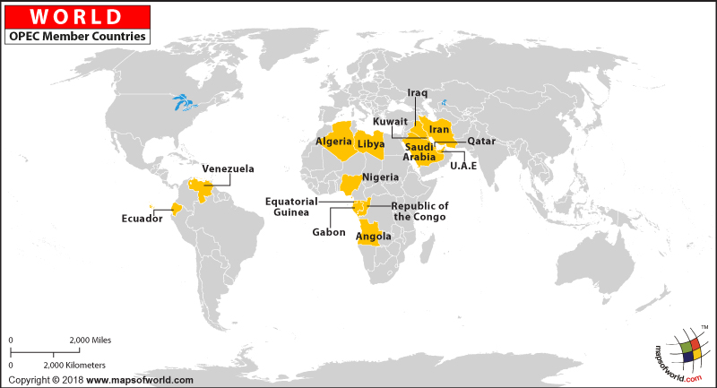
Lesson 8: Why has oil produced so much contention in the Middle East?
Oil in the Middle East
Task 3 – Using the video, add annotations to the world map. Include specific details such as years, leaders, wars, invasions and discoveries.
Task 4 – What does the future hold for the Middle East? Remember to include facts and figures to back up your opinion.

Slide 12
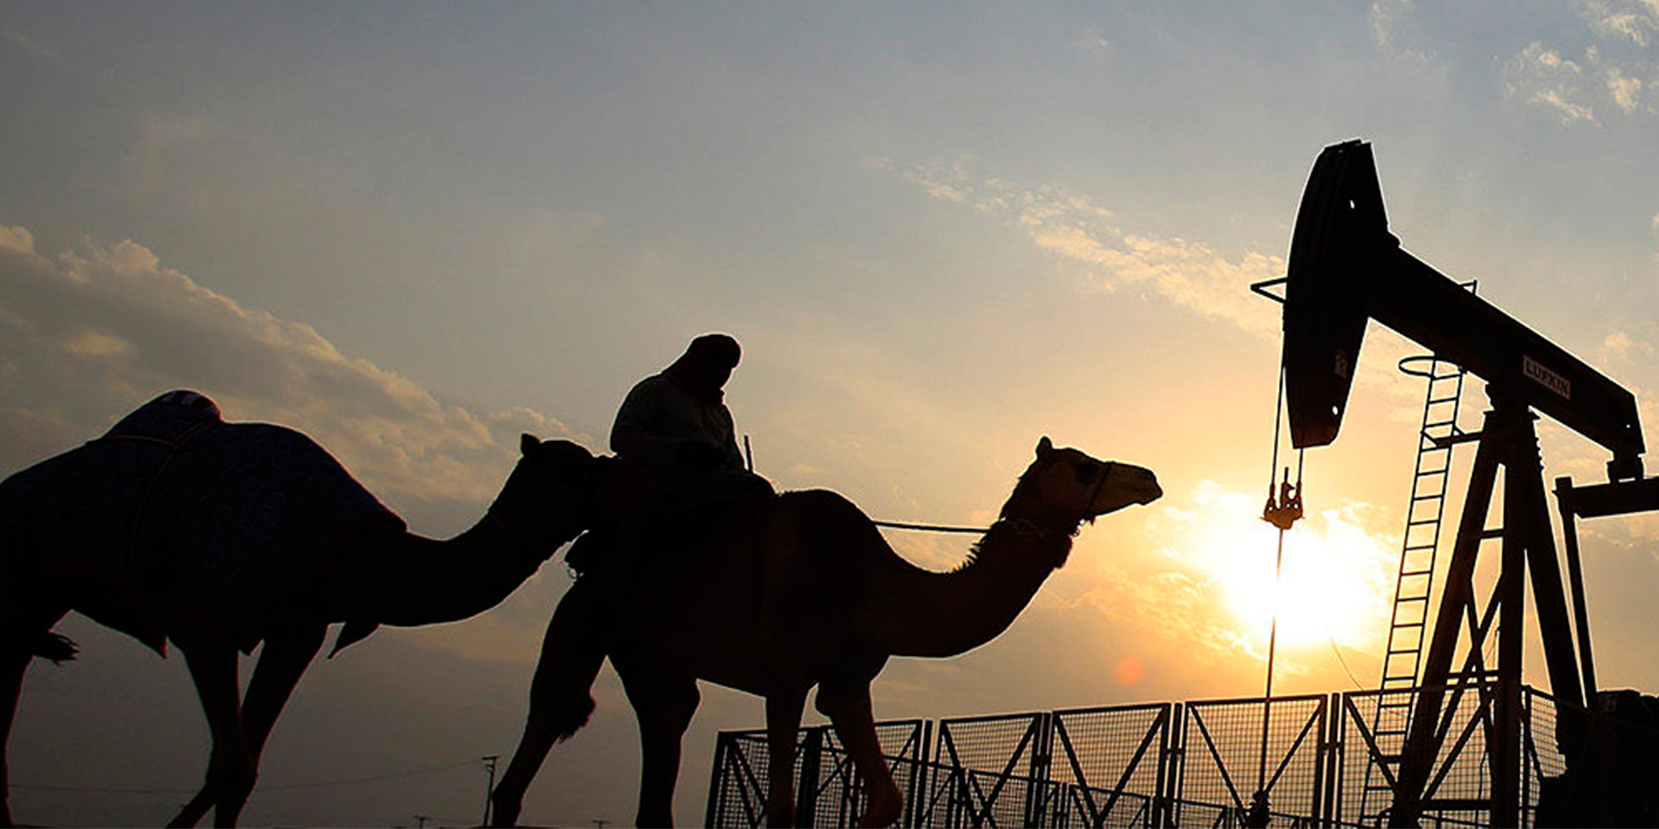
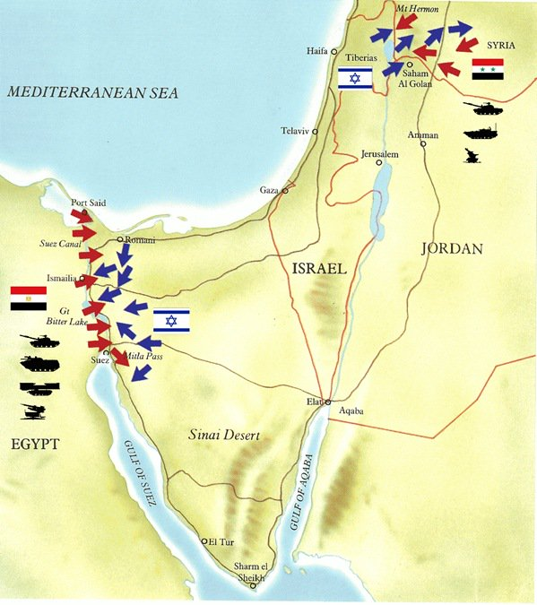
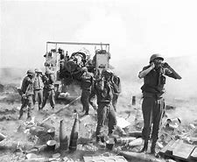
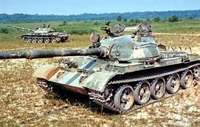
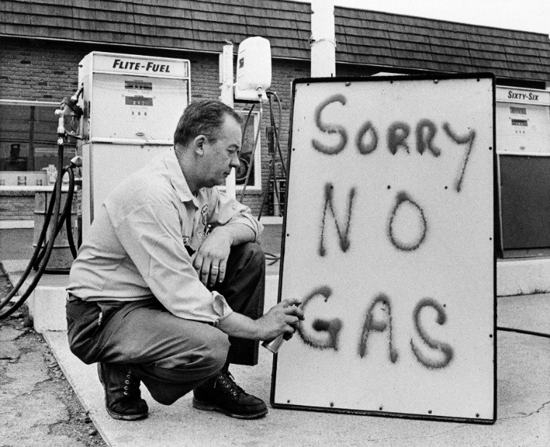
Lesson 9: Why has oil produced so much contention in the Middle East? - Assessment
Assessment
Task 1 – What are some of the causes and impacts of the Yom Kippur War?
Causes
Impacts
Stretch: What was the main cause of the war?
Task 2 – Using the images, put the statements into the correct order.
The USA support Israel in the war.
Syria and Egypt attack Israel.
Oil producing countries in the Middle East stop sending the USA oil.
Prices of oil increase dramatically (it quadrupled).
Task 3 – Explain how this conflict meant that there was a shortage of oil in the USA.

Slide 13
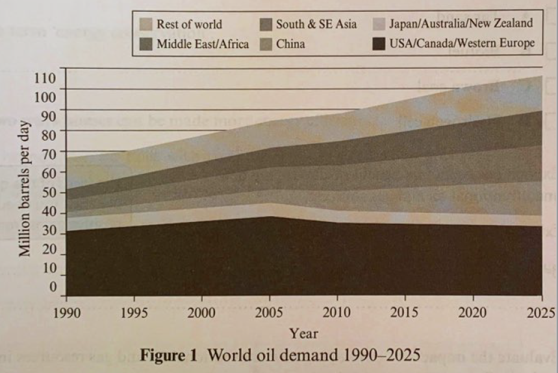
Lesson 9: Why has oil produced so much contention in the Middle East? - Assessment
Assessment
Task 4 – Exam style questions. Use the annotations around the question to help write your answers.
Rest of the World
Middle East / Africa
South and SE Asia
China
Japan / Aus / NZ
USA / Canada / Western Europe
Using figure 1 describe the changes in world oil consumption from 1990 to 2025. (3 marks)
Explain why there has been a significant increase in oil demand in some parts of the world. (3 marks)
Explain how international relations affect oil prices. (4 marks)

