Slide 1
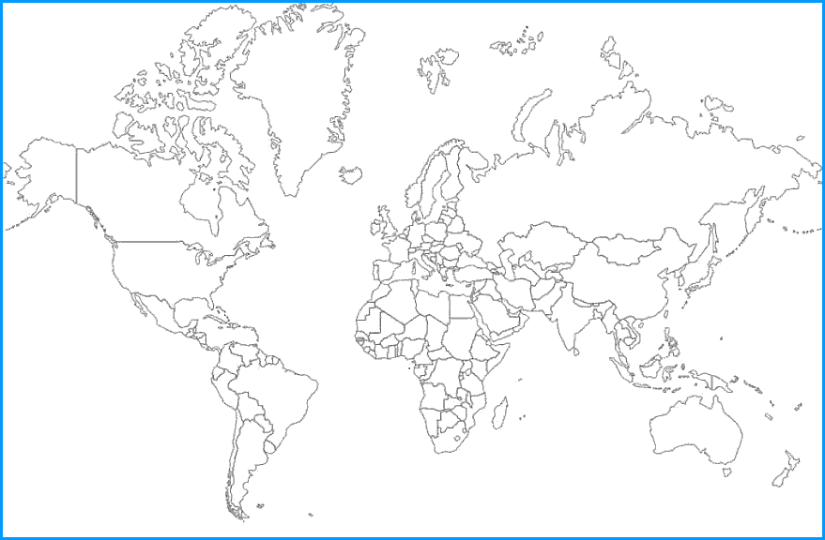
Marvelous Migration - Introduction!
Lesson 1: Should we stay where we are born?
Independent research links
Video links
The British - https://bit.ly/35XgKjm
World map - http://ontheworldmap.com/
Who are migrants? https://www.youtube.com/watch?v=yRPfM5Oj-QA&ab_channel=UNHCRTeachingAboutRefugees
Task 1 – Match up the key terminology with the correct definition.
Asylum seeker
the act of leaving one's own country to settle permanently in another; moving abroad
Emigration
a person who has left their home country as a political refugee and is seeking asylum in another
Immigration
movement from one part of a country or the world to another
Migration
a person who has been forced to leave their country in order to escape war, persecution, or natural disaster
Refugee
the action of coming to live permanently in a foreign country
Task 2.a) – Define push factors and pull factors.
Push factors: Pull factors:
Task 2.b) – Mind map specific examples for push and pull factors.
Push factors
Pull factors
Task 3 & 4 – Read through the poem ‘The British’. Add the locations of immigrants to Britain to the world map below. Once you have added your locations to the map, complete a modern verse to add the poem.
Task 5 – Give some specific examples of movements of people and why they have come to Britain.
Plenary – Should we stay where we are born? Explain why you have come to this decision.

Slide 2
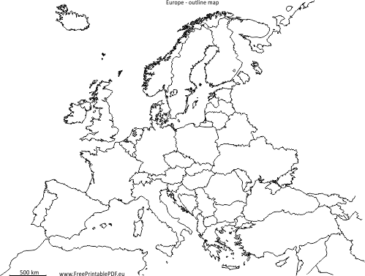
Eastern European migration
Lesson 2: Eastern European migration to the UK – how have we been affected?
Video links
Immigration the UK: https://bit.ly/3oU35CD
Impacts on host & source: https://bit.ly/2HSHI3k
Task 1: Watching the YouTube video, note down all the reasons why Eastern Europeans would migrate to the UK.
Task 2: Looking at the map of A11 countries within the EU, describe the pattern. What will the impacts of this membership be on migration to the UK?
Task 3: Fill out the table with push a pull factors, thinking specifically of people who are migrating from Eastern Europe to the UK. Categorise them into social, economic, environmental and political.
Social | Economic | Environmental | Political
Task 4: Looking at the map of registered migrant workers in the UK, describe the pattern. Why do you think migrant workers are distributed this way?
The source country is the country where migrants will be moving from e.g. Poland, Romania, Latvia
The host country is the country the migrant is moving to e.g. The UK
Task 5: Watch the YouTube video and read the newspaper resources. Complete the table below on positives and negatives for the source and host countries.
Plenary: Is migration positive or negative? Explain why. Who is it positive or negative for? (Source or host country) Explain why.
 | Host Country (UK) | Source Country (Eastern Europe)
Positives
Negatives

Slide 3
The Migrant crisis
Lesson 3: Is the ‘migrant crisis’ really a crisis?
Independent research links
Video links
The Monsoon:
https://bit.ly/31yFy0j
Migrants into the EU: https://bbc.in/2GmaIQK
Task 1 – Watch the video clip on a migrant moving into Europe. What are your initial thoughts about this situation?
Task 2 – Using the newspaper headlines, explain how the ‘crisis’ is being portrayed. What do these headlines make you instantly think? Do you think they are giving you the full story?
Task 3 – Using the data, you need to create 2 graphs and 1 map with proportional circles on.
Graph 1:
Graph 2:
Task 4 – Using the article, do you think there is a crisis? Who is it a crisis for? What will be some of the impacts of this mass movement?
Plenary – Using the key facts about asylum seekers, do you think we as a country are doing enough? What do you think we should be doing differently?

Slide 4
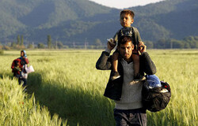
Rural to urban migration
Lesson 4: Are the bright lights of the city really worth it?
Video links
Video 1: https://www.youtube.com/watch?v=gYy1RITRN9s&ab_channel=BeautifulDestinations
Video 2: https://www.youtube.com/watch?v=FNqvyYZKK5M&ab_channel=ClothMap
Video 3: https://www.youtube.com/watch?v=c3BRTlHFpBU&ab_channel=Vox
Internal Migration – migration (movement of people) that is taking place WITHIN a particular country.
Rural-urban Migration – migration (movement of people) from rural areas (the countryside) to urban areas (towns and cities).
Favela – (Brazilian Portuguese for slum) is the generally used term for a shanty town in Brazil.
Task 1 – What do you think a favela is like to live in? Why do you think people live there?
Task 3: Answer the questions while watching the videos.
Video 3
Who designed the ‘rich’ part of the city?
What are the two different types of people called that live in Rio?
What type of gangs live in the favelas?
What 3 things do the favelas not have?
The largest favela in Rio is _________________
What have the residents of Vidigal recycled?
What has been built in Mare?
What are they using as a weapon in Providencia?
Who runs Alemao? What is this gang called?
How many deaths are caused per arrest?
Which famous singer promoted Santa Marta?
Video 1
What would attract people to move to Rio? What is there to do?
What does the quality of life look like? Why?
Video 2
Why did people start moving from rural to urban areas?
How many of Rio’s population live in favelas?
What infrastructure do they have in place?
How many businesses are run in the favela?
What was the initiative started in 2008? What does this initiative involve?
What happened during the World Cup in 2014?
Plenary – Complete the table. What impacts does rural to urban migration have on both the rural and urban areas?
Positive impacts | Negative impacts

Slide 5
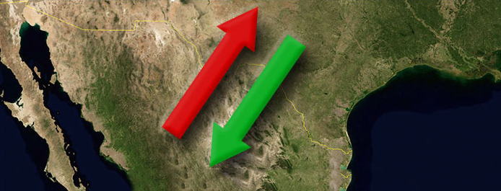
Mexico to USA migration
Lesson 5: Why do so many Mexicans want the ‘American Dream’?
Video links
Border Wars: https://www.youtube.com/watch?v=KiQdFqtZqu0&ab_channel=documentariesandeducation
Task 1 – Why would people want to migrate from Mexico to the USA? Are they push or pull factors? Write your ideas down.
Push Factors
Pull Factors
Task 2 – As you watch the documentary, answer the questions on the linked sheet from the Weebly website.
Plenary – What do you think is the most important reason that someone would migrate from Mexico to the USA?
CHALLENGE – What is your opinion on this migration? Do you think it is right? Should it be easier for someone to migrate from Mexico to the USA? Explain why you have come to that decision.

Slide 6
Assessment
Lesson 6: How should we cross the border into the USA?
Task 1 – What are the push and pull factors for Pedro leaving Mexico?
What do you think is the most important factor?
Push Factors
Pull Factors
Task 2 – Mind map the impacts of this population change.
Why do you want to move to the USA?
What route will you take into the USA? Why? Remember to include specific place names.
What job will you do when you get to California? Why? What equipment will you need for the job and your journey? How much will this cost you?
Task 3 – The BIG WRITE!
Why did you leave Mexico? (Push and pull factors) What you took and why? (Your equipment) How difficult/easy it was? Did you have any problems? Who you met along the way – did they help you? Where you crossed the border and why? Where you are staying and what it is like? What job have you got and what it is like? Things you recommend they do differently if they tried to cross the border into the USA.

