Slide 1
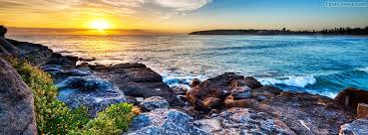
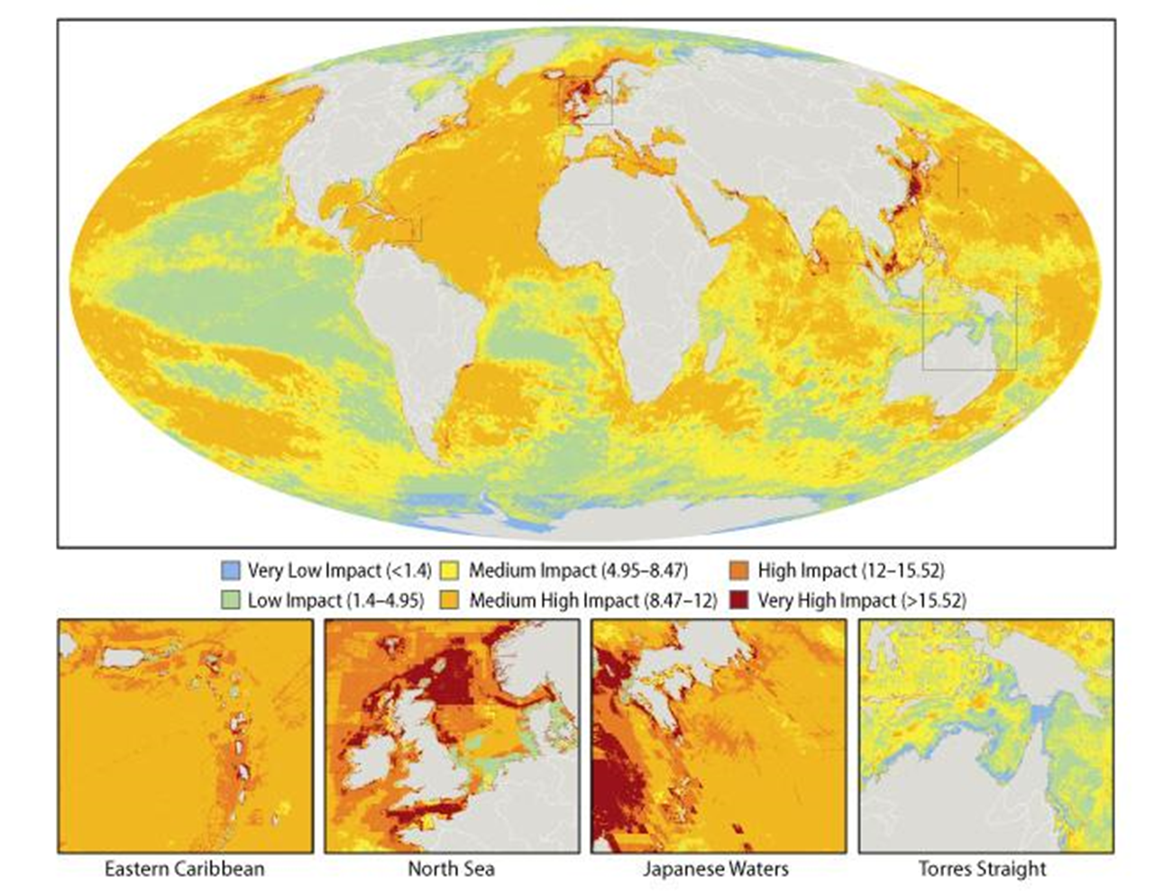
Oceans on the Edge
Lesson 1: Dead Zones
Instructions: For each worksheet page, first follow the directions for learning (in black). Second, answer the illustrating your knowledge questions (in dark blue).
Independent research links
Video links
Oceans under threat- https://bit.ly/383ZnQR
Blue Planet II- https://bit.ly/3oGvwUd
Human Activities- https://bit.ly/31X1mTa
Task 1- Use the Blue Planet II video to make a spider diagram of the key challenges facing our oceans and why they are so important. Do challenges in one colour and their importance in a second colour.
Task 2- Look at the map below. The darker areas shows areas which are experiencing high levels of environmental damage. Describe the areas that are experiencing the highest levels of damage. Challenge- explain why you think these areas are facing higher levels of damage.
Task 4- Use the ‘Oceans Under Threat’ Information to fill in the blanks. Watch the ‘Human Activities’ video to complete the human activities affecting the oceans section.
_________ ___________ are degrading and destroying marine ecosystems.
Oceans cover ____ of our planet and are home to distinctive ________ _________ communities composed of _____, aquatic plants and sea birds.
Examples of important marine ecosystems are:
Human activities affecting the oceans (video):
1.______________________________
This means…
2.______________________________
This means…
3.______________________________
This means…
Task 3- Use google to research the definitions of these key terms. Write the definitions next to the word.
Biodiversity
Food chains
Ecosystems
Dead zones

Slide 2
Oceans on the Edge
Lesson 2: Where are coral reefs and why do we value them?
Instructions: For each worksheet page, first follow the directions for learning (in black). Second, answer the illustrating your knowledge questions (in dark blue).
Independent research links
Video links
Coral Reef Bitesize- https://bbc.in/37XddUV
Where do corals live? https://bit.ly/2TCZv14
Uses of coral reefs- https://bit.ly/3kMfWUG
The perfect coral. https://bit.ly/35LozIY
Why do corals bleach? https://bit.ly/3jLgaKk
Coral reefs, Polyps in peril. https://bit.ly/34JozKc
Task 1- Watch ‘The Perfect Coral Reef’. Use it to describe what a coral reef is like and what a polyp is.
Task 2- Read the Coral Reef Bitesize information. Use it to describe what a coral reef is and describe their distribution (where they are) on the planet. Try to include at least three named places!
Task 3- Read in the information in ‘ Where do corals live?’ and watch ‘Why do coral’s bleach’. Use this to explain why corals live in certain temperatures, why they don’t tend to live deeper than 25m deep and why the water needs to be clear.
Task 4- Watch the ‘Coral Reefs, Polyps in peril’ video and read the ‘Uses of coral reefs’. Create a spider diagram to show why corals are so important.

Slide 3
Oceans on the Edge
Lesson 3- What threats do coral reefs and other marine ecosystems face?
Instructions: For each worksheet page, first follow the directions for learning (in black). Second, answer the illustrating your knowledge questions (in dark blue).
Independent research links
Video links
Saving the worlds coral reefs- https://bit.ly/3mFJ2pi
Finding Nemo- https://bit.ly/385m0Ea
Philippines Threats- https://bit.ly/2THcWNC
Task 1- Watch the finding Nemo video. Note down three possible threats to the coral reef shown in the clip!
Task 2- Read the different threats to coral reefs below. Categorize them into human, natural and human& natural. Show the categories by coloring/ highlighting them in 3 different colours.
Global warming will devastate reefs by bleaching them. Rising temperatures lead to coral stress. The algae that live within corals are expelled. This makes the coral white. | Predators, such as crown of thorns starfish (COTS), breed in nutrient-enriched environments and kill the coral.
Blast fishing with dynamite, poisoning with cyanide, and trawling reefs, all cause damage. | Overfishing of the parrot fish leads to smothering by algae which destroys reefs because there are less parrot fish eating the algae
Diseases such as black band coral disease destroy reefs. Siltation and pollution make disease more likely. | Siltation damages the way in which corals breathe and feed.
Hurricanes produce huge waves and heavy rainfall, which increases siltation. Waves also cause damage themselves. | Coral mining for sand and lime for urban development (building new houses) destroys reefs. Often coral is the only local building material available to people
Tourism causes both direct and indirect damage. | Pollution from sewage (nutrient enrichment) and from oil and toxic chemicals can kill reefs.
Local warming of oceans by El Nino causes bleaching.
Task 3- Watch the Philippines Threats video and note down what is damaging the coral reefs in this specific example.
Task 4- Further investigate the key causes of damage to coral reefs using the ‘Saving the Worlds Coral Reefs link and make a spider diagram to show your findings. You must include the different types of fishing that are the most damaging.
Challenge- off of each threat, in a different colour explain why it is a threat.

Slide 4
Oceans on the Edge
Lesson 4: What is the impact of climate change on the oceans?
Instructions: For each worksheet page, first follow the directions for learning (in black). Second, answer the illustrating your knowledge questions (in dark blue).
Independent research links
Video links
Direct/ Indirect Threats. https://bit.ly/3jJQttT
Impacts around the world- https://bit.ly/31XQLXU
Coral Bleaching- https://bit.ly/31Zw9i2
Tuvalu- https://bit.ly/34KTaae
Task 1- Watch the coral bleaching video. Use this to complete the gap fill below. Challenge: Do you think this is an example of direct or indirect threats of climate change?
Many of the world’s coral reefs suffer from_____. The coral loses _____ (bleaches) due to the loss of _____ with which it lives. Changes in ocean temperature by 1-2ºC can _____ coral. Eventually the bleached reefs weaken and _____.
colour stress bleaching algae collapse
Task 2- Note down 4 key points about direct and indirect impacts of climate change on oceans using the ‘Direct/ Indirect Threats’ information.
Direct Threats | Indirect Threats
v
LESSON 4 CONTINUES ON THE NEXT PAGE.

Slide 5
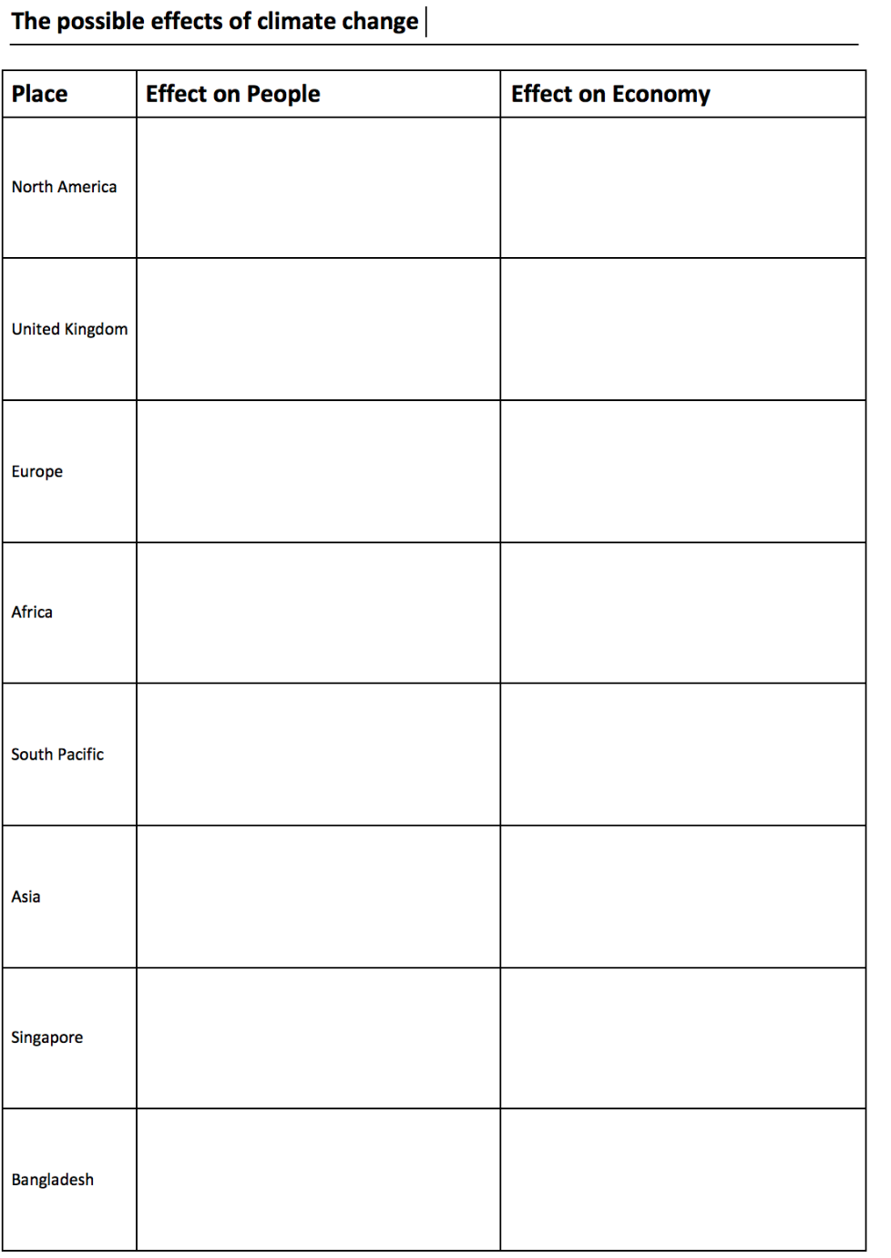
Oceans on the Edge
Lesson 4: What is the impact of climate change on the oceans?
Instructions: For each worksheet page, first follow the directions for learning (in black). Second, answer the illustrating your knowledge questions (in dark blue).
Independent research links
Video links
Direct/ Indirect Threats. https://bit.ly/3jJQttT
Impacts around the world- https://bit.ly/31XQLXU
Coral Bleaching- https://bit.ly/31Zw9i2
Tuvalu- https://bit.ly/34KTaae
Task 4- Read the information about ‘Threats around the world. Use it to complete the table below showing the social and economic impacts in different places around the world. The first one has been done for you.
1-20million potentially inundated. 10-20million in USA and 1-4million in Canada.
300,000 homes along our coast worth $117.5 billion today are at risk of becoming chronically flooded

Slide 6
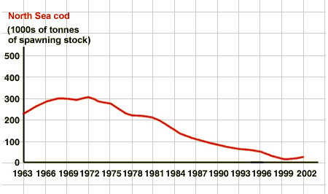
Oceans on the Edge
Lesson 5: How do we manage oceans locally?
Instructions: For each worksheet page, first follow the directions for learning (in black). Second, answer the illustrating your knowledge questions (in dark blue).
Independent research links
Video links
North Sea management- https://bit.ly/34QgB23
St Lucia Local Management- https://bit.ly/360gD6y
(Optional) North Sea Fishing- https://bit.ly/35LzUJ2
Task 1-
Look at this graph. Write a BETA paragraph to describe what it shows. Remember, B- What are the numbers at the beginning, E- What are they by the end? T- What is the overall trend/ pattern (has it increased or decreased). Anomaly- is there anything that doesn’t fit the trend?
Task 2- Use the ‘North Sea Management‘ information to produce a spider diagram to show what would need to be in a whole ecosystem approach to managing the North Sea.
Challenge: Explain how global warming could impact cod stocks.
Managing
North Sea
Fisheries
Task 3- Use the ‘St Lucia Local Management’ information to answer the following questions.
Which people were involved in developing the SMMA?
Why do you think it is important to involve all these people?
What different zones did the SMMA set up, and why do you think they are useful?
What problems and successes has the SMMA had?
Challenge: What would you change about the scheme to improve it. Why? Look at the ‘why was protection needed’ section.

Slide 7
Oceans on the Edge
Lesson 6: How do we manage oceans globally
Instructions: For each worksheet page, first follow the directions for learning (in black). Second, answer the illustrating your knowledge questions (in dark blue).
Independent research links
Video links
Great pacific garbage patch- https://bit.ly/366h4g3
The Ocean Clean-up- https://bit.ly/2GfMnvT
Protecting our oceans- https://bit.ly/3oH4kVr
Task 1- Read the information about the Great Pacific Garbage Patch.
Use it to answer these questions.
What is it?
How is it formed?
What types of waste are in it?
Why is it dangerous to marine mammals and other parts of the food chain?
Task 2- Use the video about the ‘Ocean clean up’ to make a spider diagram summarising one of solving this problem.
The Ocean Cleanup
Watch the video by David Attenborough about ‘Protecting our Oceans’.
Firstly, describe what we are doing to continually damage our oceans.
Secondly, describe how we can change this in the future.
Now, using all of your knowledge from this topic, why is it so important that we do commit to saving our oceans and how do you think we should it? Local methods or global methods?

