Slide 1
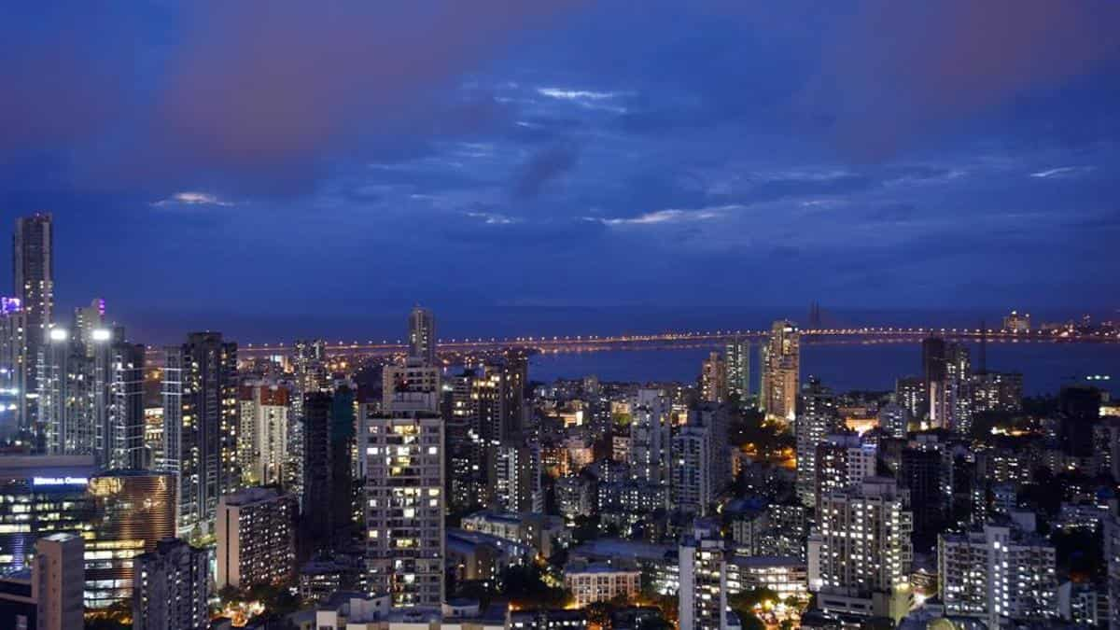
Plenary Task
Mumbai Quiz

Slide 2
Question 1
When was Mumbai’s name officially changed to Bombay?
1982
1987
1995
2000

Slide 3
Question 2
How many people live in Mumbai Dharavi Slum?
253,000
300,000
850,000
1,000,000

Slide 4
Question 3
Which of the following Indian Industries is the largest in the world?
Fashion
Film
Pharmaceutical
Computers

Slide 5
Question 4
Mumbai overlooks what large body of water?
Arabian Sea
Bay of Bengal
Indian Ocean
Andaman Sea

Slide 6
Question 5
What event does Mumbai’s Gateway of India commemorate?
The city’s statue as an international port
India’s independence from Britain
King George V’s 1911 visit
The victims of the 1896 plague

