Slide 1
Raging
Rivers
Pupil
Workbook

Slide 2
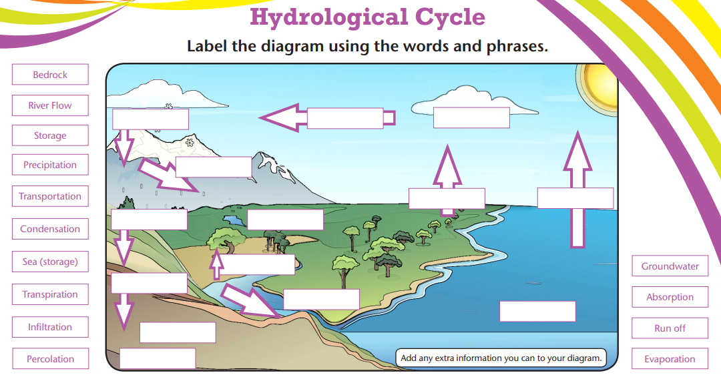
Lesson 1: What is the hydrological cycle?
Watch this video and read over this Bitesize review about the hydrological cycle and then complete the diagram using the words and phrases below.
The following statements describe the hydrologic cycle as illustrated above. Examine the illustration and write the word(s) that best fit the blanks. Select the word(s) from the following list. Each word may be used only once.
evaporate liquid atmosphere runoff condensation gas clouds precipitation wind snow groundwater transpiration oceans
The ________________ are great storehouses of water. They hold about 97% of the world’s water.
The heat of the sun causes water to ______________ from the ocean. It becomes water vapour which is an invisible _____________.
The moisture-laden air is blown by the _____________ toward the land.
As air rises, it cools. It eventually reaches the point where it can no longer hold all of its moisture in gaseous form. Some of the water vapour changes into a _______________ around particles of dust, to form tiny droplets of water. When water vapour changes into water, the process is called _____________. We can see the results of this process in the atmosphere in the form of _________________ that are carried by the wind.
Many droplets of water join together and fall to earth as ____________________.
If temperature conditions are suitable, the water vapour may change directly into a solid form. This produces ___________________.
When the rain reaches the ground, or snow melts, the water can follow one of four paths:
evaporate back into the ___________________
__________________ along the surface of the earth
sink into the earth and become ______________________
be released into the atmosphere from the leaves of plants by the process of ____________

Slide 3
Lesson 2: How does a river flow from source to mouth?
The profile of a river changes as it moves through the upper, middle and lower courses. You will now learn how a river’s profile changes using this webpage and video.
Figure 2 a river profile
What happens to the width of the valley? [1]
Describe the changes in gradient from the upper to lower course. [2]
Identify what landforms are found in the middle course. [1]
Describe the change in geomorphic processes from the upper to lower course. [1]

Slide 4
The Bradshaw Model
The Bradshaw Model is a geographical model that represents how a river’s characteristics change downstream (from source to mouth).
In the table below, complete the following tasks:
Create definitions for each
characteristic.
Identify how it changes downstream (e.g. increase/decrease etc).
Explain why the characteristic changes downstream.

Slide 5
Lesson 3: What processes shape the land around a river?
Geomorphic processes shape distinctive river landscapes in the UK through weathering, mass movement, erosion, deposition and transportation. Read about these processes and watch this video before attempting the tasks below.
Erosion | Weathering
Write each process in the correct column in the table above.
Freeze-thaw, Hydraulic Action, Abrasion, Biological, Attrition, Solution, Carbonation, Oxidation.
Define the process of saltation. [1]
Define the process of abrasion. [1]
Define the process of freeze-thaw weathering. [1]
The table below names three weathering processes. Use arrows to
match each process with the correct description. [2]
Process | Description
Biological | Breakdown of rocks into smaller rocks by water, ice or wind.
Mechanical | The disintegration of rocks caused by reactions.
Chemical | Rocks are broken down by living organisms including animals and plants.

Slide 6
River Processes
Transportation | Erosion
Write each process in the correct column in the table above. Hydraulic Action, Attrition, Abrasion, Saltation, Solution, Solution, Suspension, Traction, Corrasion.
Define the process of attrition. [1]
Define the process of traction. [1]
Define the process of chemical weathering. [1]
The table below names four transportation. Use arrows to match each process with the correct description. [3]
Process | Description
Suspension | Particles of sediment are dissolved by the river.
Traction | Large boulders are rolled along the river bed.
Solution | Small pieces of sediment bounce along the river bed.
Saltation | Particles of sediment float in the river’s flow.

Slide 7
River Processes
Complete the definitions for the different types of erosion below by selecting the key words from the bank below:
Hydraulic action- the power of the as it smashes against the banks. Air becomes trapped in the in the rock causing it to break apart.
Abrasion- pebbles grind along the river bed, much like . Overtime the bed, banks and rocks .
Attrition- this is when rocks in the river knock against each other.
Overtime they break into smaller and more rocks.
Solution- this is when the river water certain rocks. In the UK, alkali rock such as is prone to this process of erosion.
Water, Cracks, Sandpaper, Smoothen, Rounded, Chalk, Dissolve.
Using the image below, annotate to show how each type of erosion
causes the river bed and banks to be worn away.

Slide 8
Lesson 4: What river landscapes (landforms) are created by a river?
Rivers create a range of distinctive landforms in the UK which include ox-bow lakes, meanders, levees, floodplains, v-shaped valleys, waterfalls and gorges. Read all about river landforms here and watch this video before attempting the tasks below.
1. Explain the stages in formation of a
levee. [3]
Showing ‘stages’ is often best done by using diagrams. Draw an annotated diagram below using the key terms in the key terms box.
Stage 1
Stage 2
Stage 3
Key terms
Deposition, floodplain, flood, river channel
2. Study Figure 3 which shows High Force, England. Label the features of this landform. [3]
Figure 3 High Force, England

Slide 9
River Landscapes (Landforms)
Rivers create a range of distinctive landforms in the UK which include ox- bow lakes, meanders, levees, floodplains, v-shaped valleys, waterfalls and gorges.
1. Explain the stages in formation of an
ox-bow lake. [3]
Showing ‘stages’ is often best done by using diagrams. Draw an annotated diagram below using the key terms in the key terms box.
Stage 1
Stage 2
Stage 3
Key terms
Erosion, swans neck, flood, river channel
2. Study Figure 4 which shows a meander. Label the features of this landform. [3]
Figure 4 a meander cross section

Slide 10
River Landscapes (Landforms)
River landforms including gorges, waterfalls, meanders, ox-bow lakes are all found in different courses of a river.
1. In the table below, categorise the landforms found in a river into: upper, middle or lower. You may want to colour code this.
Meander | Floodplain | Waterfall
Ox-bow Lake | V-Shaped Valley | Mouth (Estuary)
Levee | Gorge | Delta
2. Explain the formation of a V-Shaped valley. [4]
_
_
_
_
_
_
_
_
Want More- Try These!
Explain the formation of a gorge. [3]
Explain the formation of a floodplain. [4]
Explain the formation of a waterfall. [4]
Explain the formation of a levee. [4]
Explain the formation of an ox-bow lake. [4]

Slide 11
Lesson 5: What causes some rivers to flood?
Rivers can flood due to human and physical factors. An example would be humans building on floodplains either side of a river. Read over this detail on river flooding and watch this video before attempting the tasks below.
Human | Physical
Write each process in the correct column in the table above.
Building on floodplains, heavy rainfall, lack of dredging, building a dam,
deforestation, steep sided land, storm surges.
Figure 5, an upland area is shown below.
Annotate (label) Figure 5 to show what would increase and decrease the risk of flooding.
Figure 5 an upland area

Slide 12
Lesson 6: How are rivers managed?
River landscapes in the UK can be managed using different strategies. These are known as hard and soft engineering. These strategies have both positives and negatives to people and the environment. Read about these strategies here and watch this video before attempting the tasks below.
1. Study Figure 6, which shows a photograph of a river management strategy. What is shown in Figure 6? [1]
A Groyne B Dam
C Afforestation
D Flood Wall
Figure 6 a river management strategy
2. How does the management strategy benefit the river landscape? [2]
3. Explain how the river management strategy impacts the environment negatively. [3]
4. What is soft engineering? [1]
5. What is hard engineering? [1]

Slide 13
River Management
River landscapes in the UK can be managed using different strategies. These are known as hard and soft engineering. These strategies have both positives and negatives to people and the environment.
1. Study Figure 7, which shows a photograph of a river management strategy. What is shown in Figure 7? [1]
A Afforestation B Deforestation C Aplantation D Levee
Figure 7 a river management strategy
2. How does the management strategy benefit the river landscape? [2]
3. How might the management strategy not reduce the risk of flooding? [2]
4. Explain the advantages and disadvantages of using hard engineering strategies to protect a river. [4]

Slide 14
Lesson 7: The Kielder - Providing Water
River landscapes in the UK have been modified to provide water for humans and industry. These modifications to provide water have positives and negatives. Kielder Water in Northumberland, NE England is an example. Read over this case study detail before attempting the tasks below.
1. Study Figure 8, which shows a photograph of Kielder Water. What is shown in Figure 8? [1]
A Reservoir B Levee
C Flood Wall
D Dredge
Figure 8 Kielder Water
Kielder Water is a reservoir located in Northumberland. It took 7 years to build. It was built to supply heavy industry on Teesside , Wearside and Tyneside. It has a 1.2 km dam which is 50m high.
The impacts of Kielder Water are noted below. Categorise the impacts of Kielder Water into positives (+) and negatives (-):
Deforestation on a large scale.
Sediment builds up behind the Kielder Dam which causes pollution.
The construction of the dam and the reservoir used large machinery which released greenhouse gases which contributed to global warming.
Reduced flood risk and can create tourism improving the local economy and employment opportunities.
2700 acres of farm land was destroyed.
See the next page to answer a question based on
this example.

Slide 15
Kielder: Providing Water
2. Discuss the impacts in the construction of Kielder Water.
[6]
Highlight the +/-
Consider the overall judgement-
was it positive or negative?
Overall?

